Slide 1
Today: An Experiment
3 people have mentioned to me that they really miss the handwriting from Manuel’s lectures.
But at least one person was quite perplexed to hear I would abandon the clarity of slides.
Today I’ll do an experiment where I’ll handwrite on my slides. Let me know what you think at the end!
Based on a discussion after lecture I’m also going to try to put up a type-set set of slides that is easier to read than my handwriting. That is this set of slides.
(May need to do some minor fixes morning of Nov 21)

Slide 2
Continuous Probability Distributions
Lecture 23, CS70 Fall 2025

Slide 3
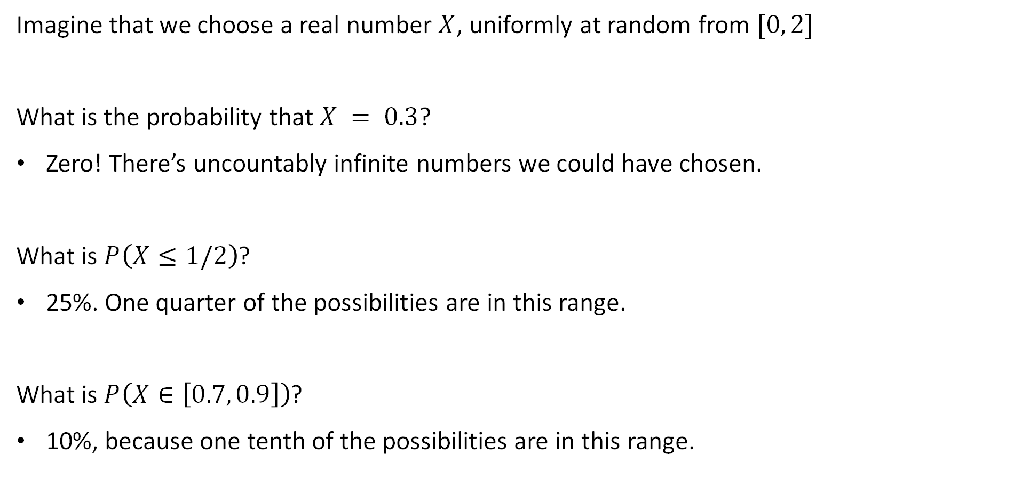
Framing: A Random Variable with Range [0, 2]
Imagine that we choose a real number $X$, uniformly at random from $[0, 2]$
What is the probability that $X = 0.3$?
Zero! There’s uncountably infinite numbers we could have chosen.
What is $P\left(X≤1/2\right)$?
25%. One quarter of the possibilities are in this range.
What is $P\left(X∈\left[0.7, 0.9\right]\right)$?
10%, because one tenth of the possibilities are in this range.

Slide 4
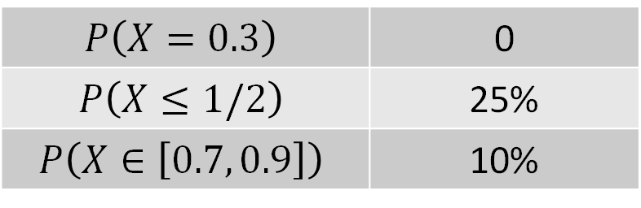
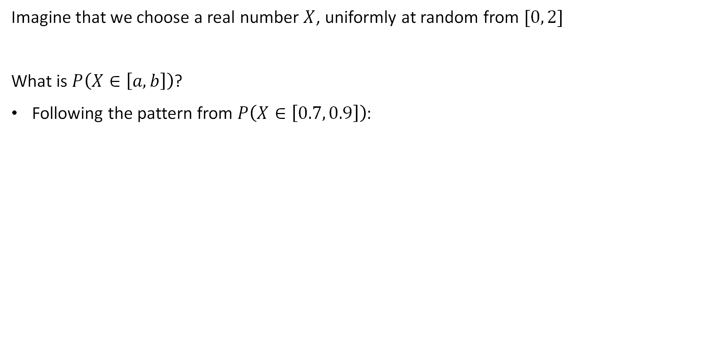
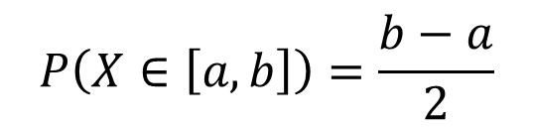
Framing: A Random Variable with Range [0, 2]
Imagine that we choose a real number $X$, uniformly at random from $[0, 2]$
What is $P\left(X∈\left[a, b\right]\right)$?
Following the pattern from $P\left(X∈\left[0.7, 0.9\right]\right)$:
$$P\left(X∈\left[a, b\right]\right)=\frac{b−a}{2}$$
$$P\left(X=0.3\right)$$ | 0
$$P\left(X≤1/2\right)$$ | 25%
$$P\left(X∈\left[0.7, 0.9\right]\right)$$ | 10%

Slide 5
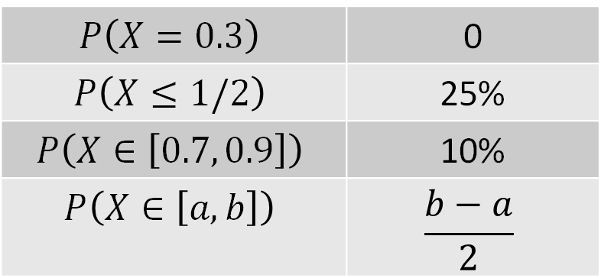
Framing: A Random Variable with Range [0, 2]
Imagine that we choose a real number $X$, uniformly at random from $[0, 2]$
What is $P\left(X∈\left[a, b\right]\right)$?
Following the pattern from $P\left(X∈\left[0.7, 0.9\right]\right)$:
$$P\left(X∈\left[a, b\right]\right)=\frac{b−a}{2}$$
$$P\left(X=0.3\right)$$ | 0
$$P\left(X≤1/2\right)$$ | 25%
$$P\left(X∈\left[0.7, 0.9\right]\right)$$ | 10%
$$P\left(X∈\left[a, b\right]\right)$$ | $$\frac{b−a}{2}$$

Slide 6
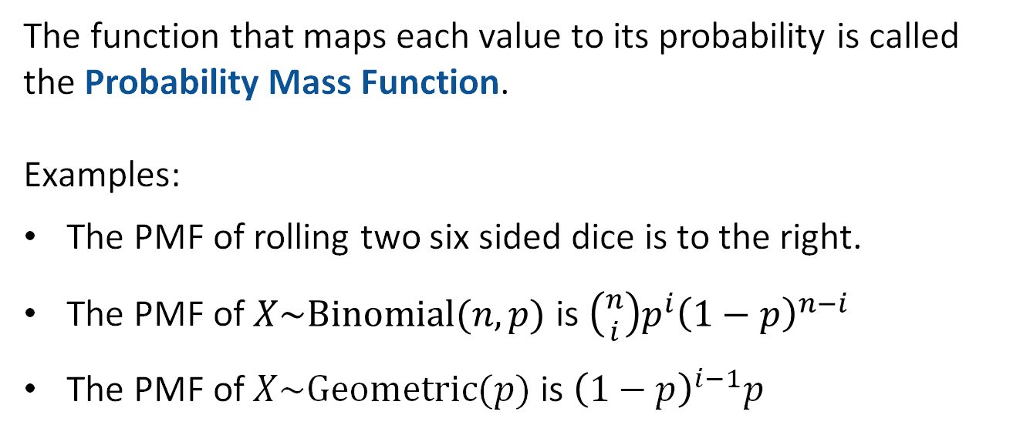
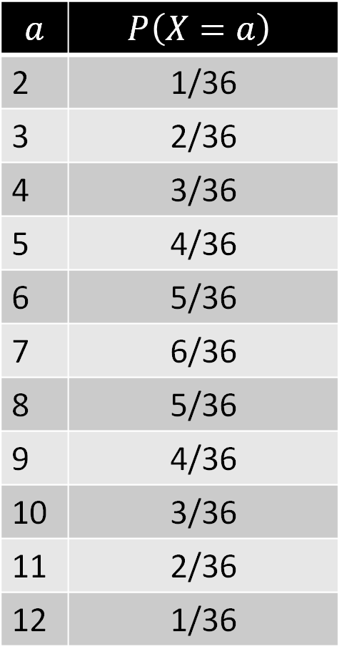
Review: Distributions of Discrete Random Variables
For a discrete random variable, we have the notion of the distribution of a random variable.
Enumeration of every value and its probability.
$$a$$ | $$P\left(X=a\right)$$
2 | 1/36
3 | 2/36
4 | 3/36
5 | 4/36
6 | 5/36
7 | 6/36
8 | 5/36
9 | 4/36
10 | 3/36
11 | 2/36
12 | 1/36
The function that maps each value to its probability is called the Probability Mass Function.
Examples:
The PMF of rolling two six sided dice is to the right.
The PMF of $X\sim Binomial(n, p)$ is $\left({n \atop i}\right)p^{i}{\left(1−p\right)}^{n−i}$
The PMF of $X\sim Geometric(p)$ is ${\left(1−p\right)}^{i−1}p$
PMF is just a new term for something we’ve seen before.

Slide 7
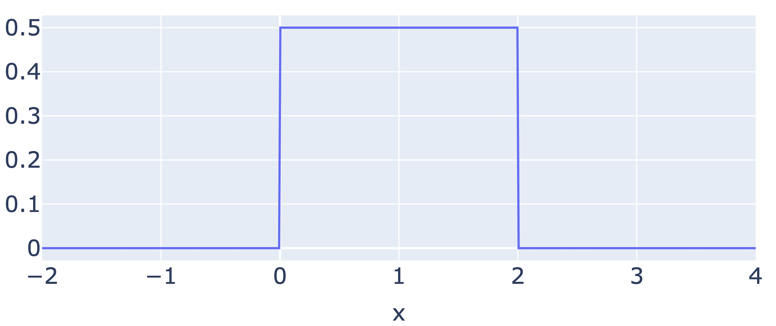
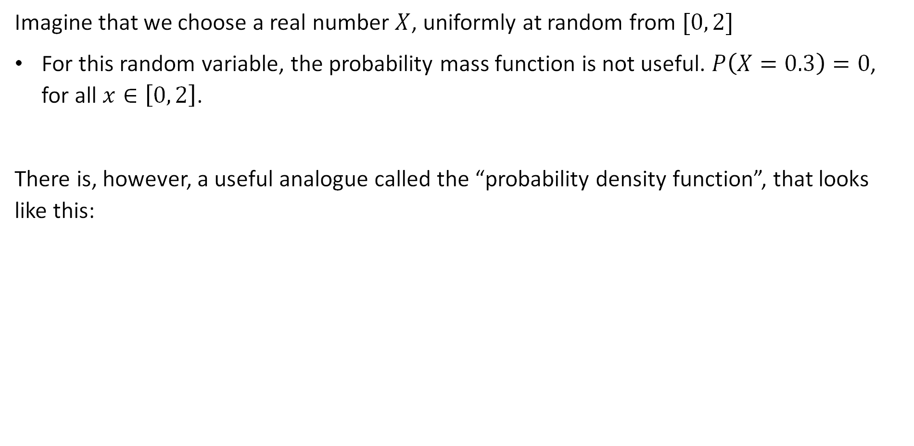
Framing: A Random Variable with Range [0, 2]
Imagine that we choose a real number $X$, uniformly at random from $[0, 2]$
For this random variable, the probability mass function is not useful. $P\left(X=0.3\right)=0$, for all $x∈\left[0, 2\right]$.
There is, however, a useful analogue called the “probability density function”, that looks like this:

Slide 8
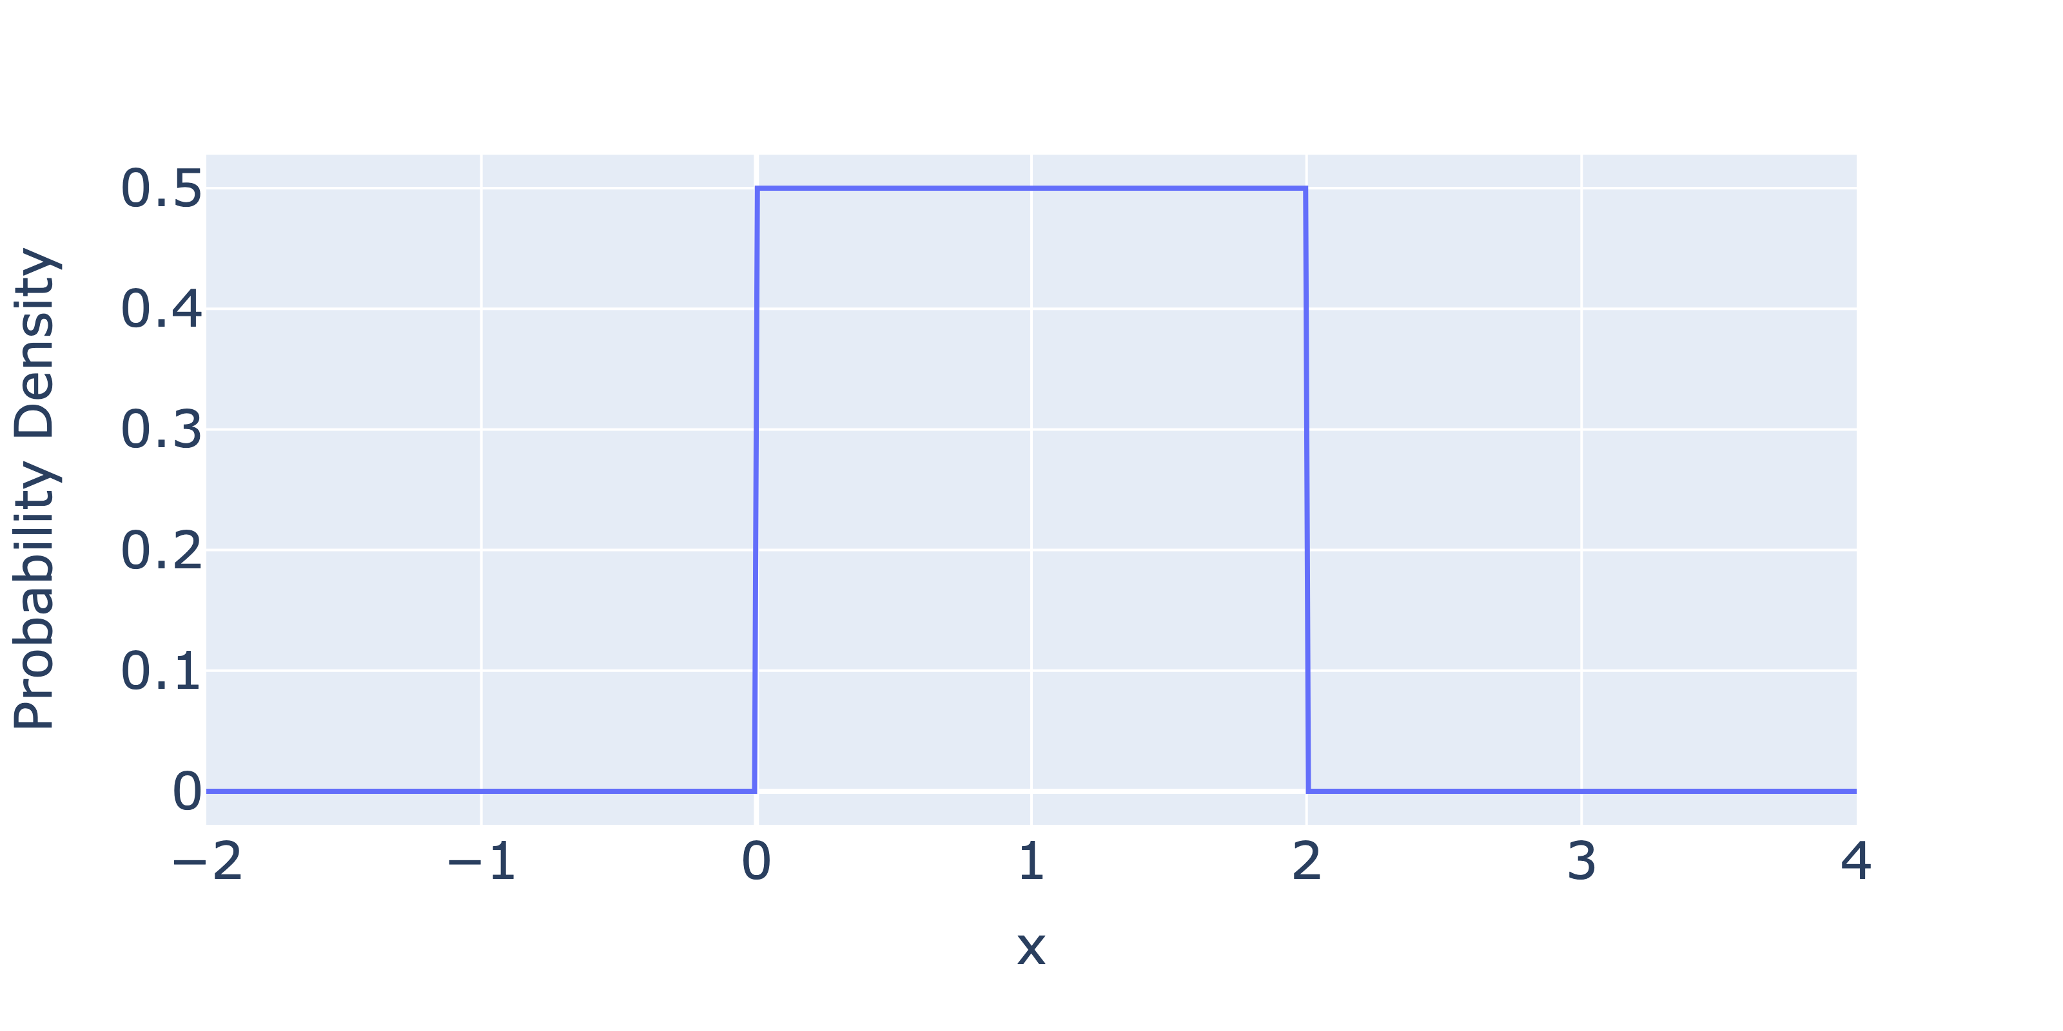

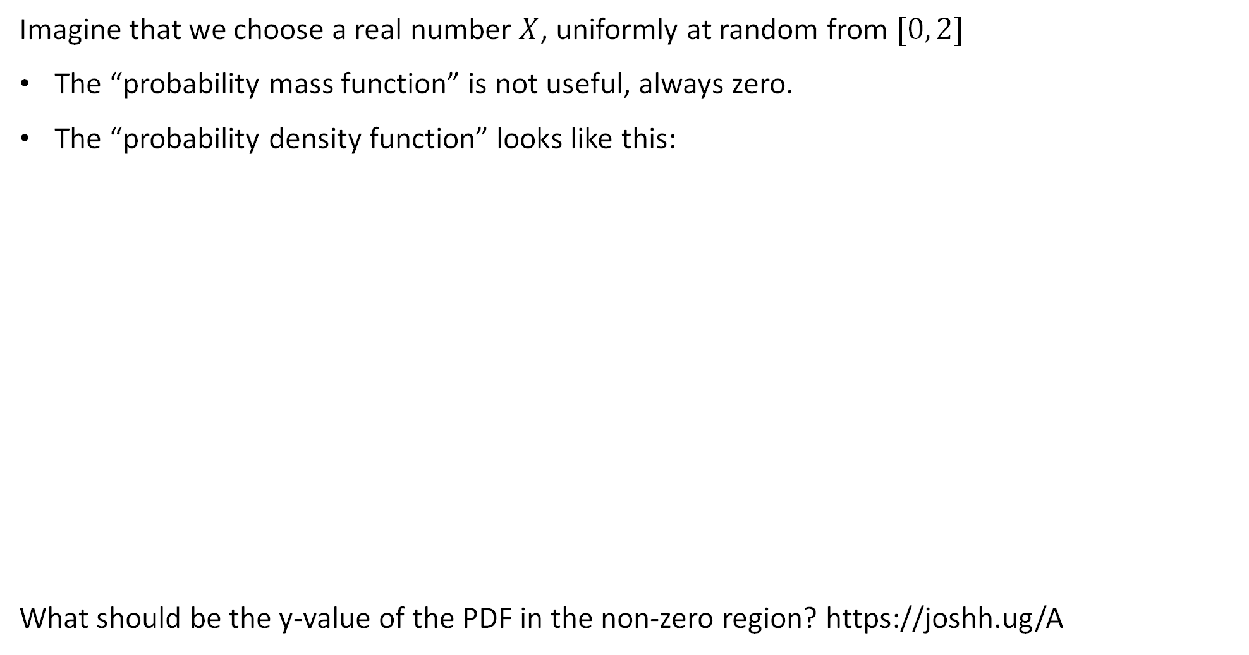
Framing: A Random Variable with Range [0, 2]
Imagine that we choose a real number $X$, uniformly at random from $[0, 2]$
The “probability mass function” is not useful, always zero.
The “probability density function” looks like this:
What should be the y-value of the PDF in the non-zero region? https://joshh.ug/A

Slide 9
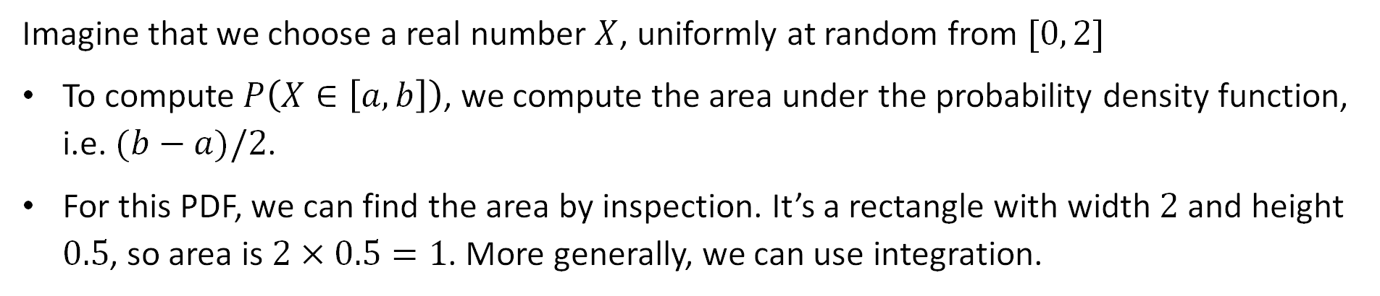
Framing: A Random Variable with Range [0, 2]
Imagine that we choose a real number $X$, uniformly at random from $[0, 2]$
To compute $P\left(X∈\left[a, b\right]\right)$, we compute the area under the probability density function, i.e. $(b−a)/2$.
For this PDF, we can find the area by inspection. It’s a rectangle with width $2$ and height $0.5$, so area is $2×0.5=1$. More generally, we can use integration.
I picked 0.5!

Slide 10

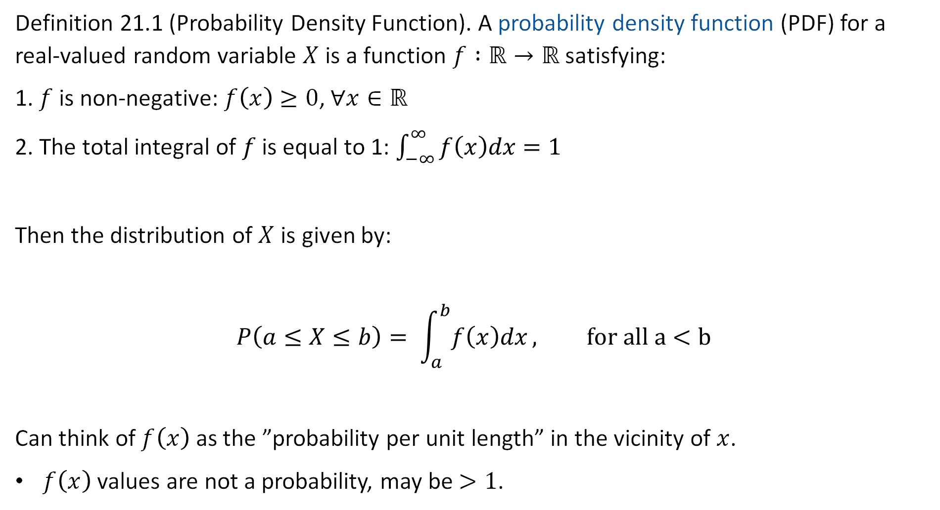
Probability Density Function (as described in the notes)
Definition 21.1 (Probability Density Function). A probability density function (PDF) for a real-valued random variable $X$ is a function $f :ℝ→ℝ$ satisfying:
1. $f$ is non-negative: $f\left(x\right)≥0$, $∀x∈ℝ$
2. The total integral of $f$ is equal to 1: $\int_{−∞}^{∞}{f\left(x\right)dx=1}$
Then the distribution of $X$ is given by:
$$P\left(a≤X≤b\right)= \int_{a}^{b}{f\left(x\right)dx}, for all a<b$$
Can think of $f\left(x\right)$ as the ”probability per unit length” in the vicinity of $x$.
$f\left(x\right)$ values are not a probability, may be $>1$.
PDF is usually lowercase $f$

Slide 11

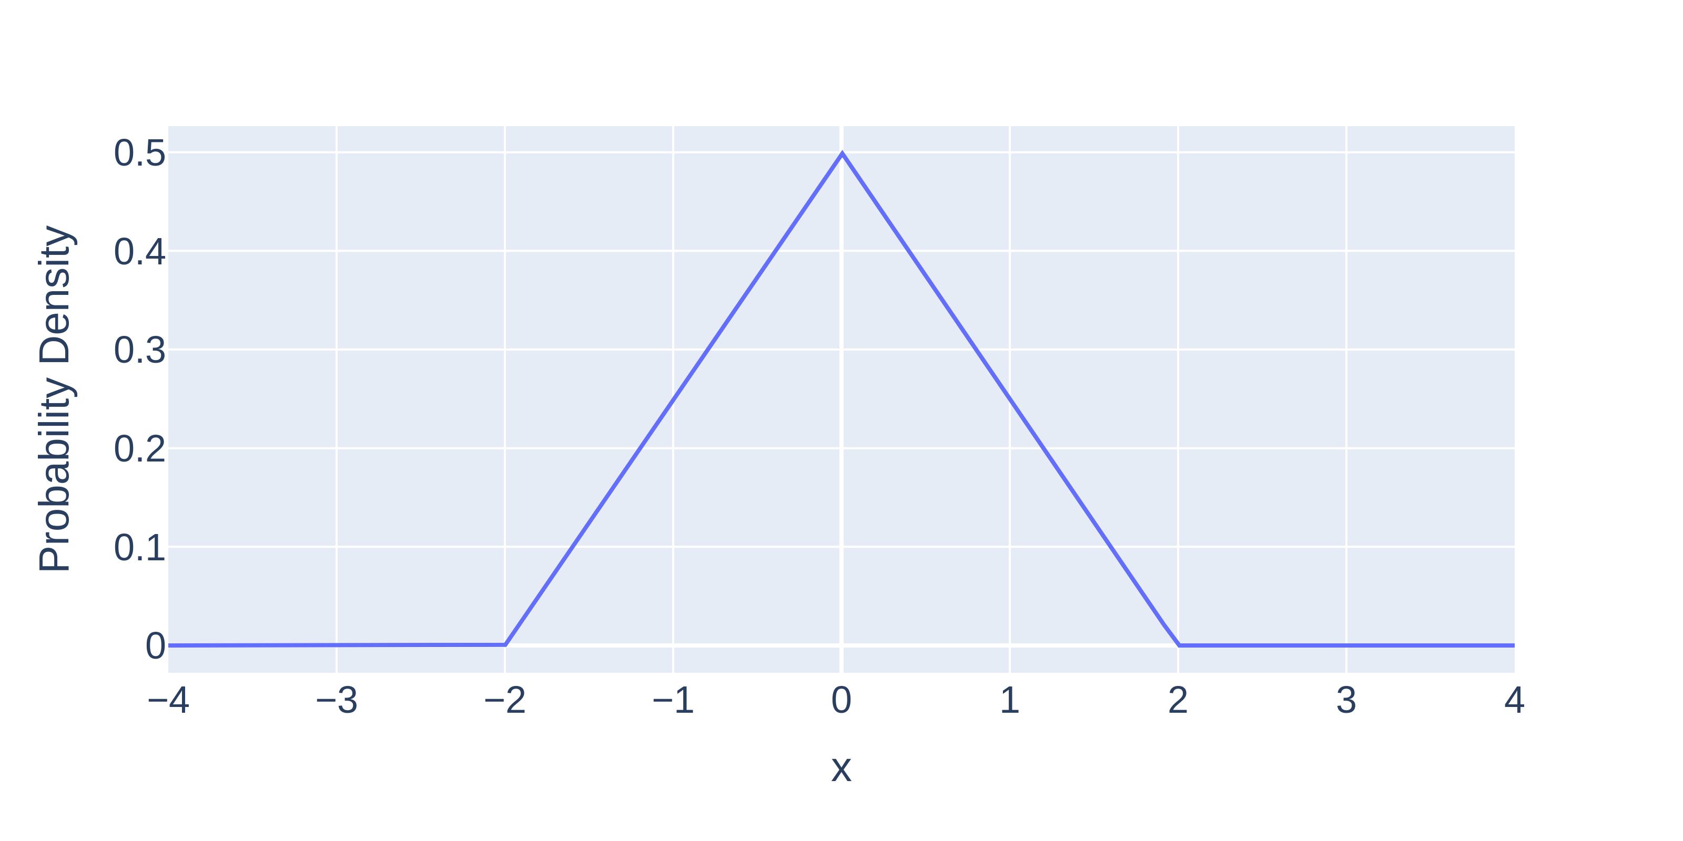
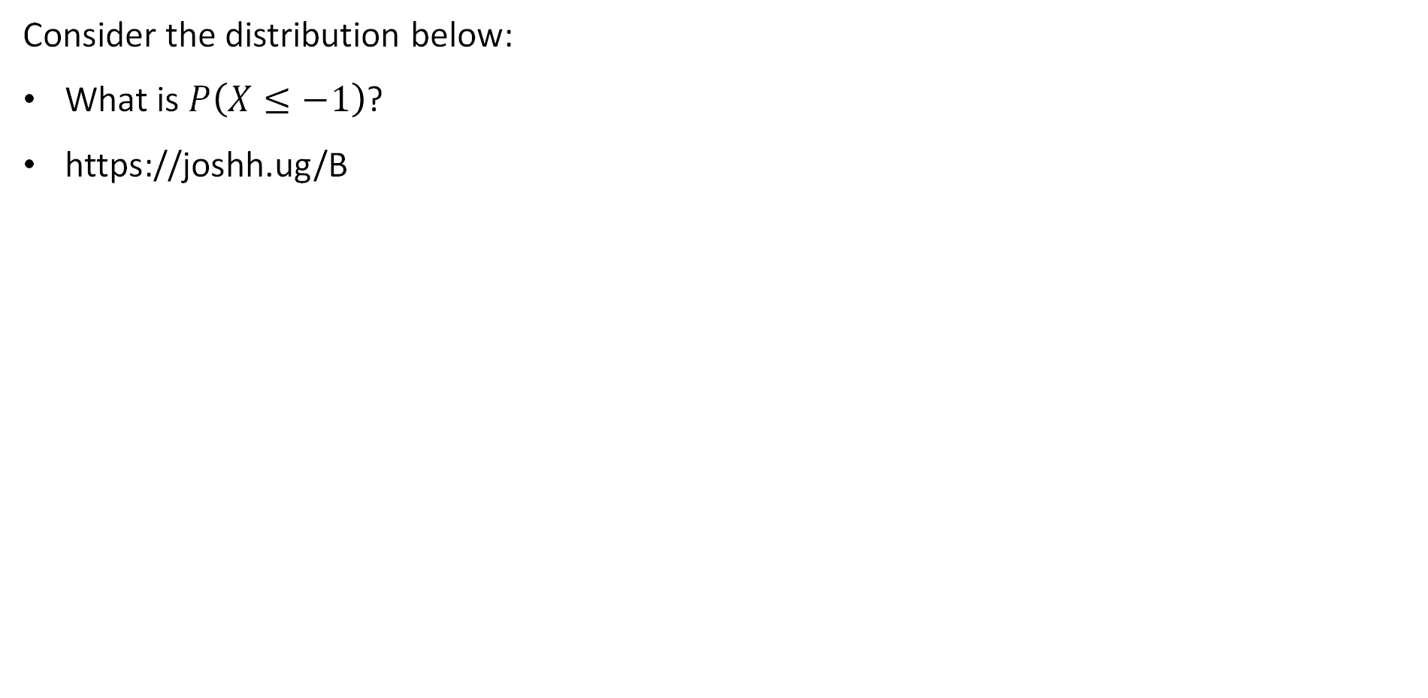
Another Example Distribution: The Triangle Distribution
Consider the distribution below:
What is $P\left(X≤−1\right)$?
https://joshh.ug/B

Slide 12
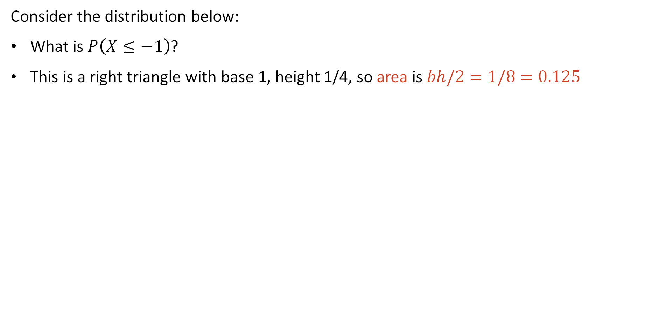
Another Example Distribution: The Triangle Distribution
Consider the distribution below:
What is $P\left(X≤−1\right)$?
This is a right triangle with base 1, height 1/4, so area is $bh/2=1/8=0.125$

Slide 13

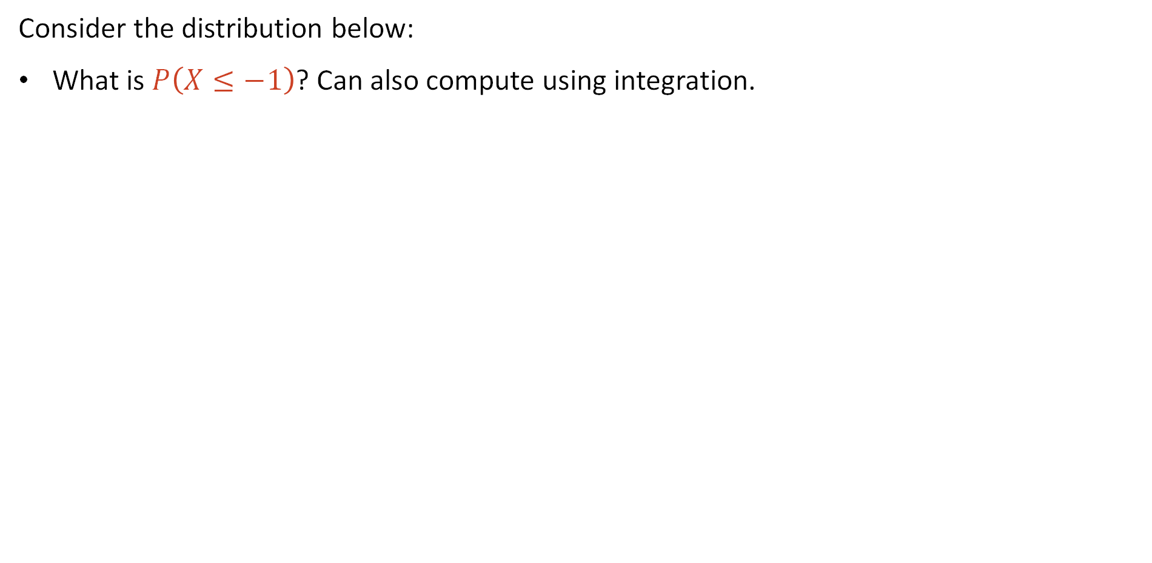
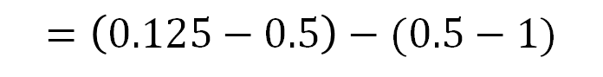
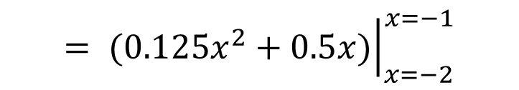
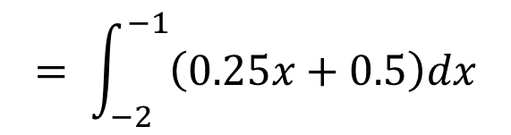
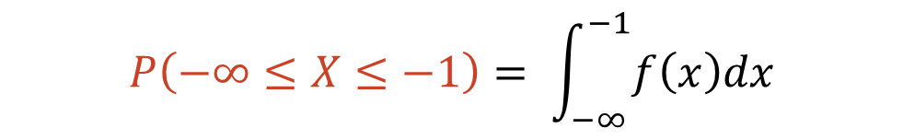
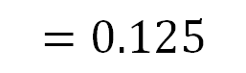
Another Example Distribution: The Triangle Distribution
Consider the distribution below:
What is $P\left(X≤−1\right)$? Can also compute using integration.
$$P\left(−∞≤X≤−1\right)= \int_{−∞}^{−1}{f\left(x\right)dx}$$
$$= \int_{−2}^{−1}{\left(0.25x+0.5\right)dx}$$
$$= {\left.(0.125x^{2}+0.5x)\right|}_{x=−2}^{x=−1}$$
$$=\left(0.125−0.5\right)−(0.5−1)$$
$$=\left(0.125−0.5−0.5+1\right)$$
$$=0.125$$
Hypotenuse of triangle is a line with slope 0.25 and y-intercept 0.5

Slide 14
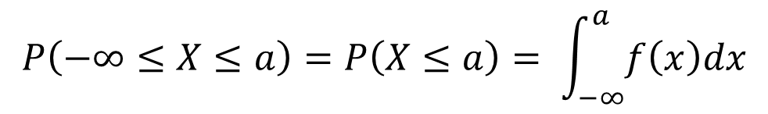
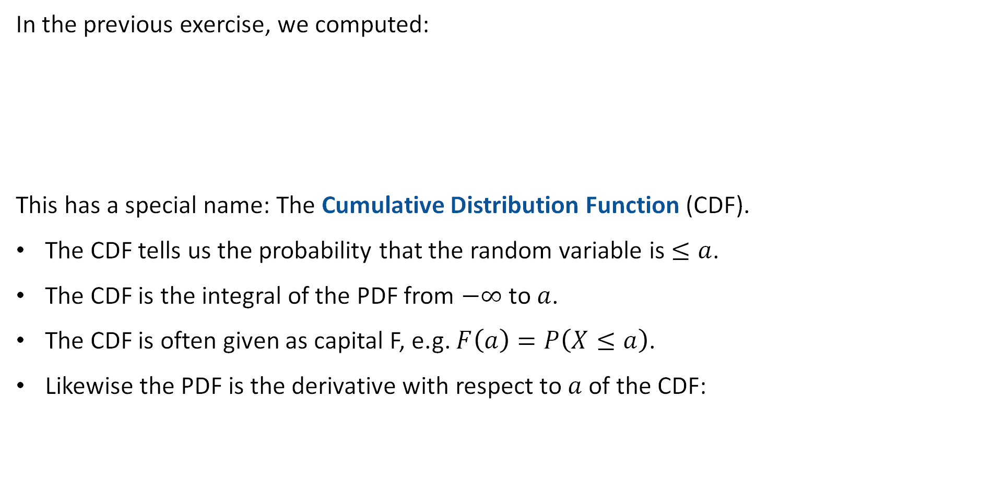

The Cumulative Density Function
In the previous exercise, we computed:
This has a special name: The Cumulative Distribution Function (CDF).
The CDF tells us the probability that the random variable is $≤a$.
The CDF is the integral of the PDF from $−∞$ to $a$.
The CDF is often given as capital F, e.g. $F\left(a\right)=P\left(X≤a\right)$.
Likewise the PDF is the derivative with respect to $a$ of the CDF:
$$P\left(−∞≤X≤a\right)=P\left(X≤a\right)= \int_{−∞}^{a}{f\left(x\right)dx}$$
$$f\left(a\right)=\frac{dF\left(a\right)}{da}$$

Slide 15
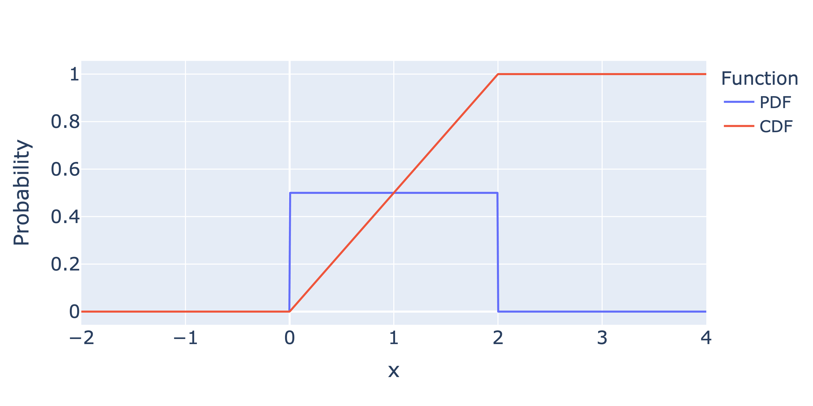
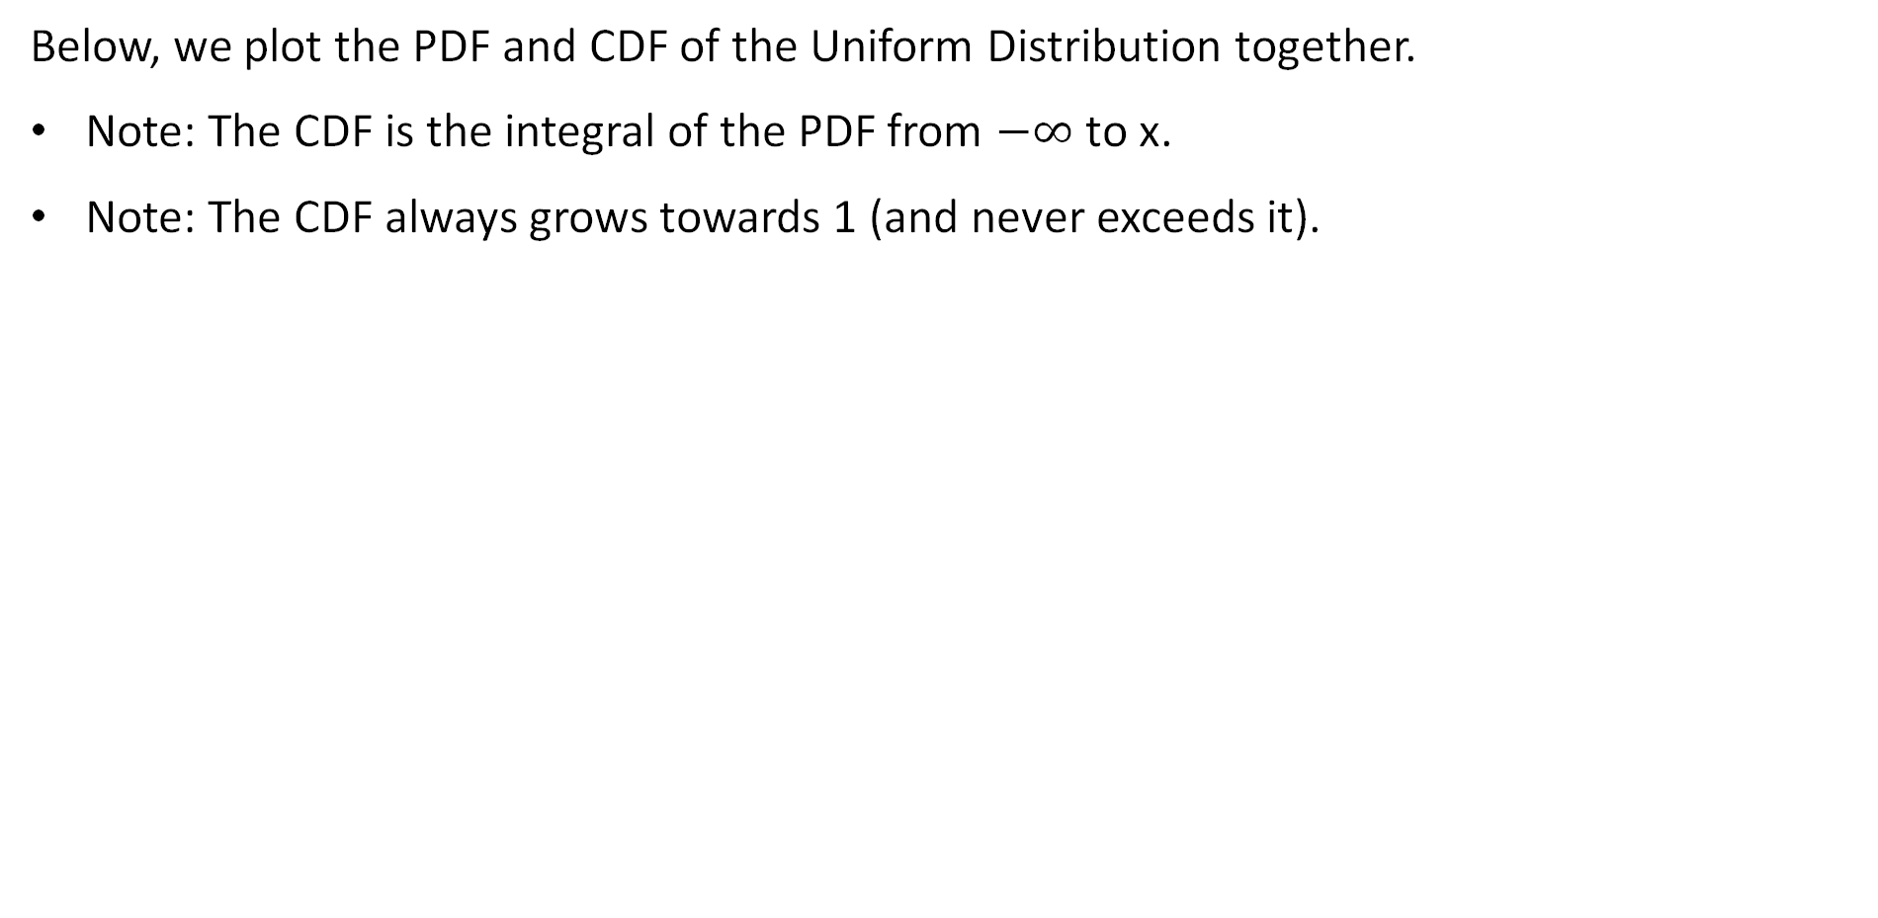

Cumulative Density Function Example 1: Uniform Distribution
Below, we plot the PDF and CDF of the Uniform Distribution together.
Note: The CDF is the integral of the PDF from $−∞$ to x.
Note: The CDF always grows towards 1 (and never exceeds it).
PDF: Probability per unit length
CDF: $P(X≤x)$

Slide 16
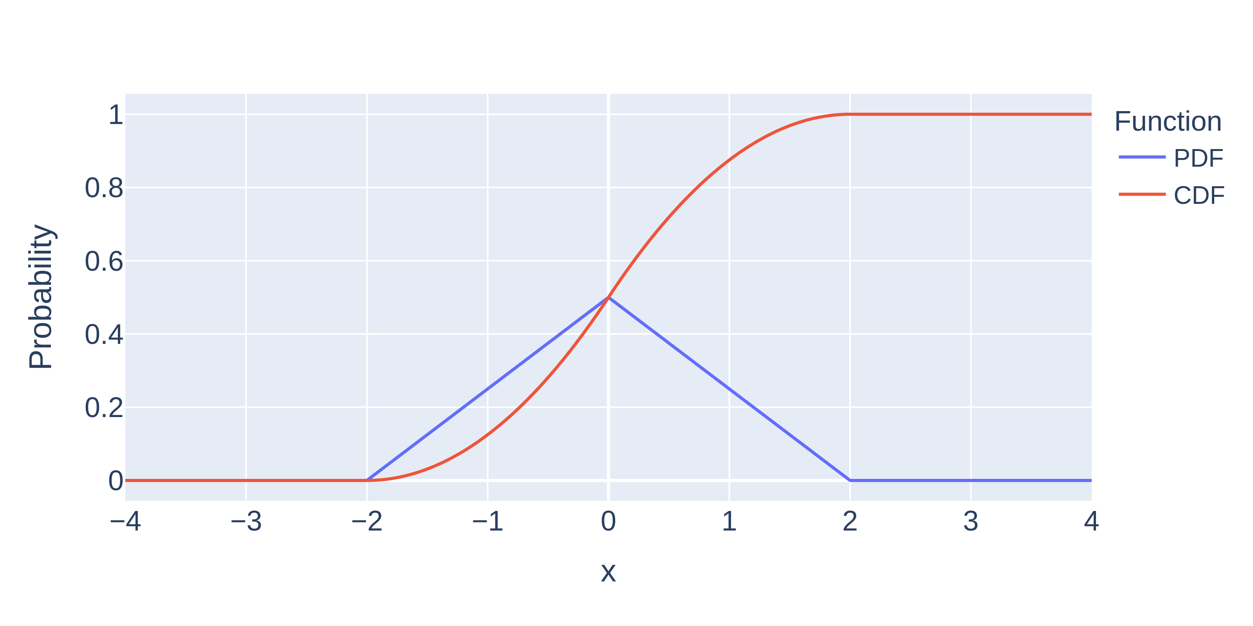
Cumulative Density Function Example 2: Uniform Distribution
Below, we plot the PDF and CDF of the Uniform Distribution together.
Note: The CDF is the integral of the PDF from $−∞$ to x.
Note: The CDF always grows towards 1 (and never exceeds it).
Integral of a line is a parabola.
PDF: Probability per unit length
CDF: $P(X≤x)$

Slide 17
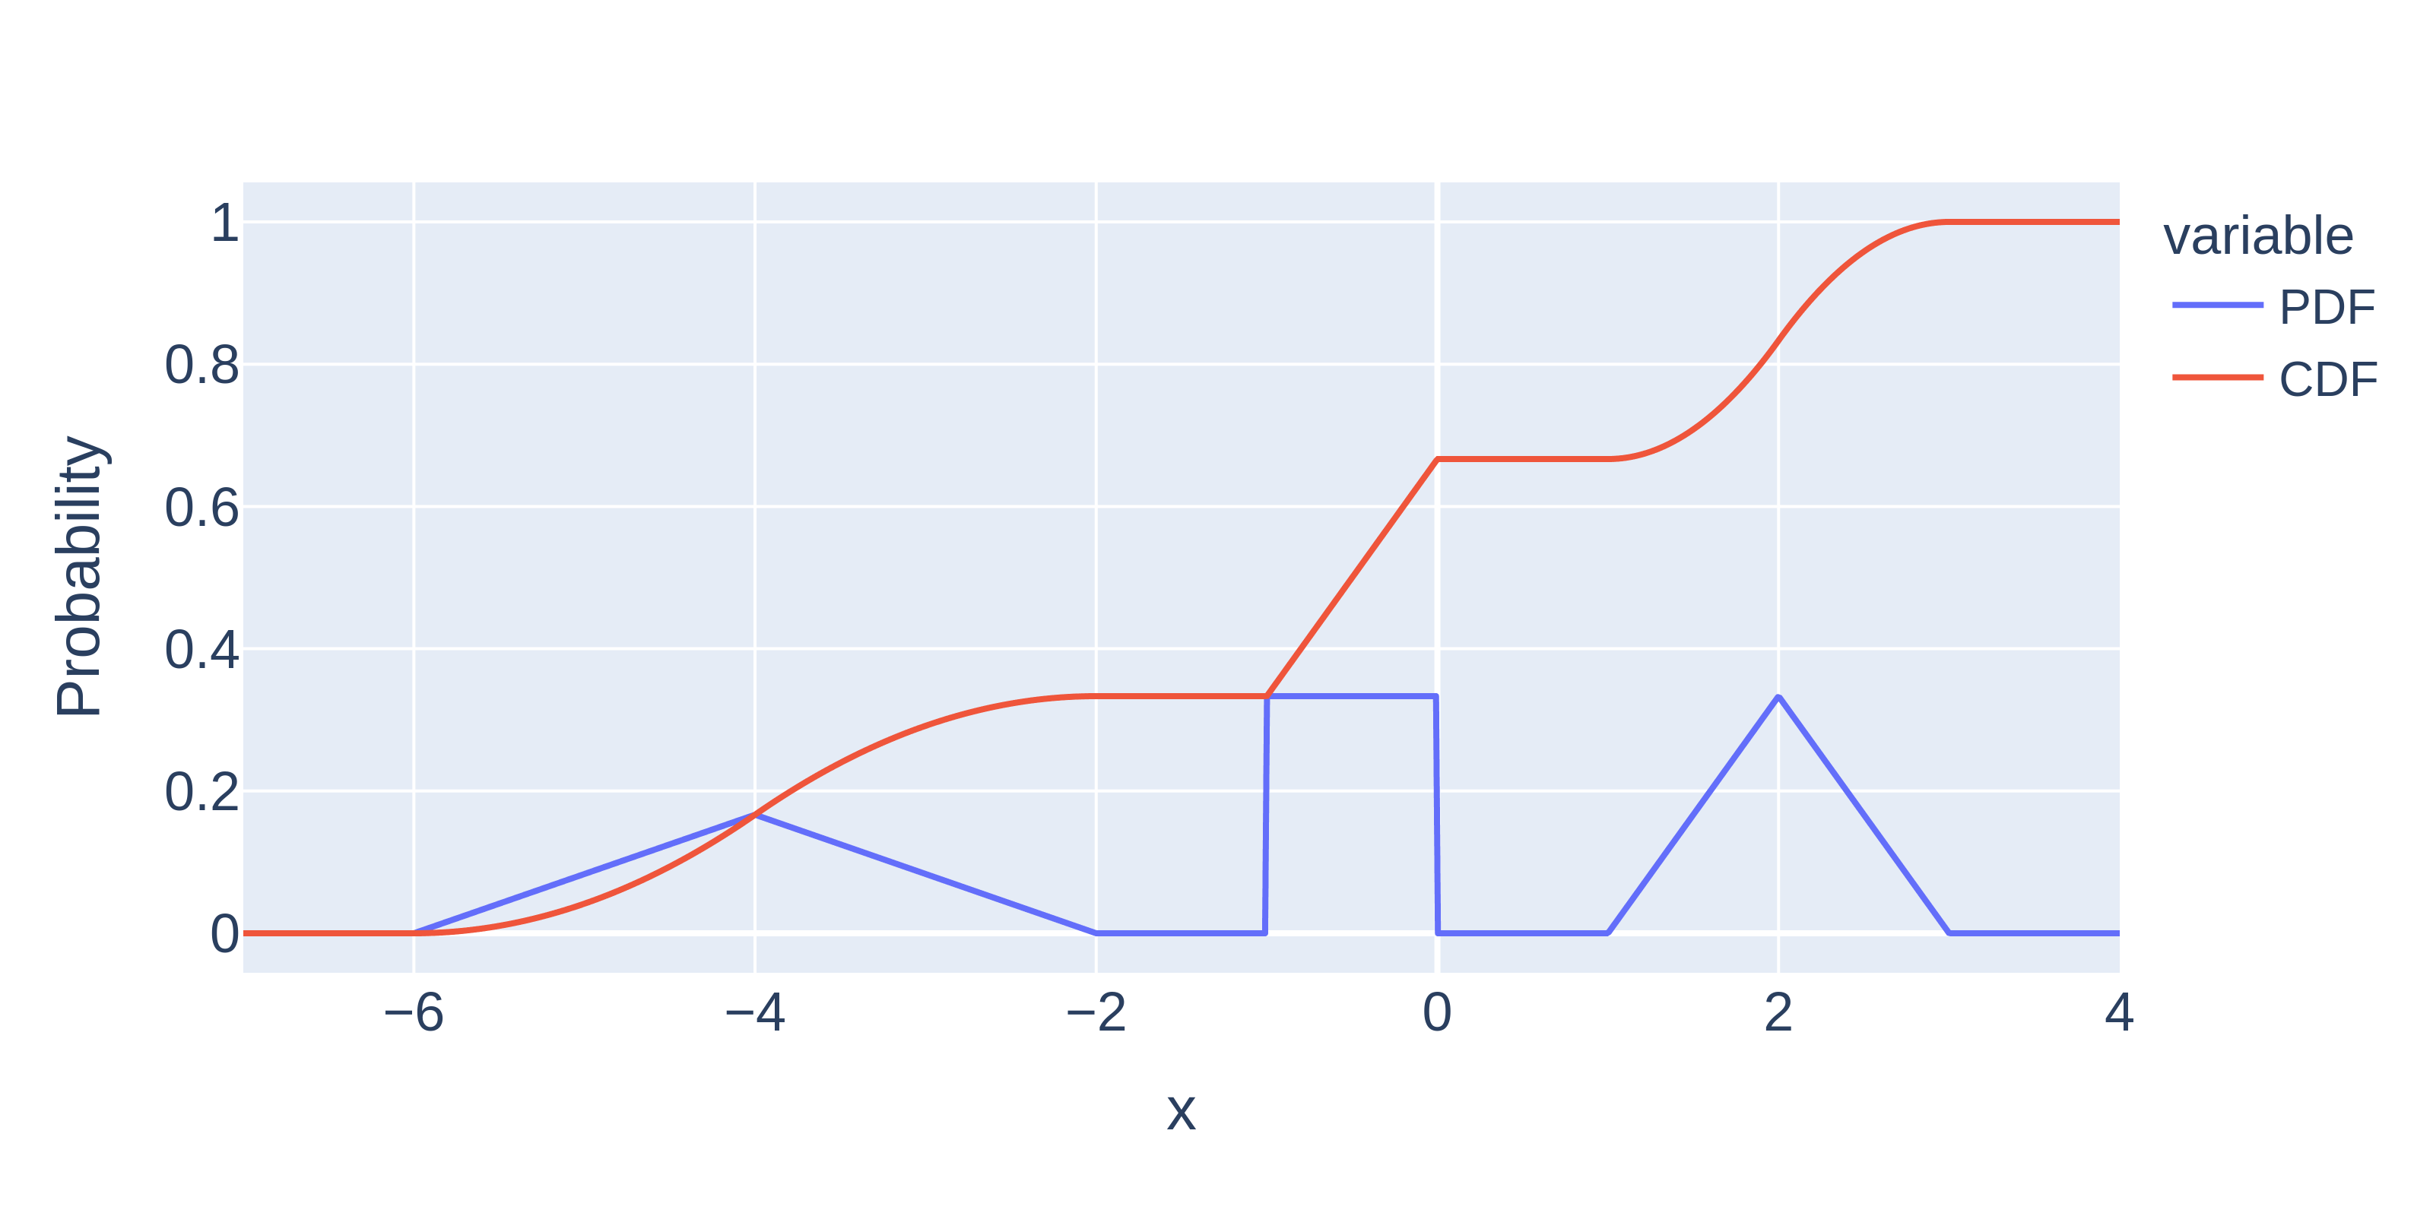
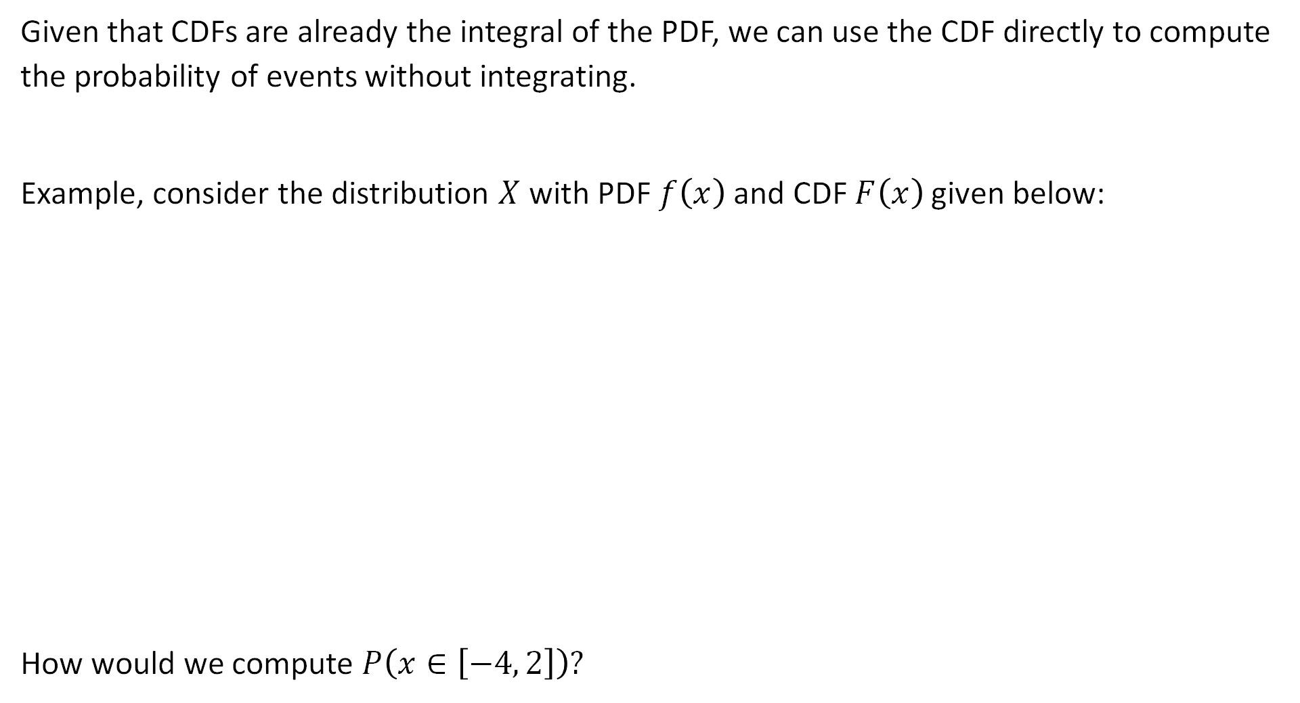
Applying a CDF
Given that CDFs are already the integral of the PDF, we can use the CDF directly to compute the probability of events without integrating.
Example, consider the distribution $X$ with PDF $f\left(x\right)$ and CDF $F\left(x\right)$ given below:
How would we compute $P\left(x∈\left[−4, 2\right]\right)?$

Slide 18
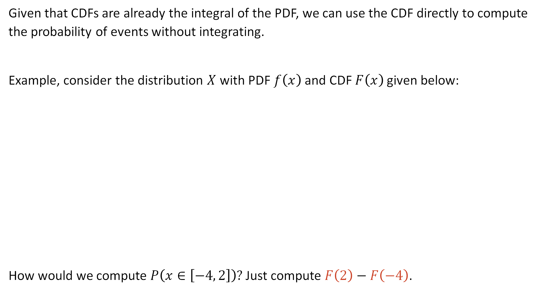
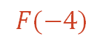
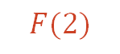
Applying a CDF
Given that CDFs are already the integral of the PDF, we can use the CDF directly to compute the probability of events without integrating.
Example, consider the distribution $X$ with PDF $f\left(x\right)$ and CDF $F\left(x\right)$ given below:
How would we compute $P\left(x∈\left[−4, 2\right]\right)?$ Just compute $F\left(2\right)−F\left(−4\right)$.
$$F(2)$$
$$F(−4)$$

Slide 19
The Exponential Distribution
Lecture 23, CS70 Fall 2025

Slide 20
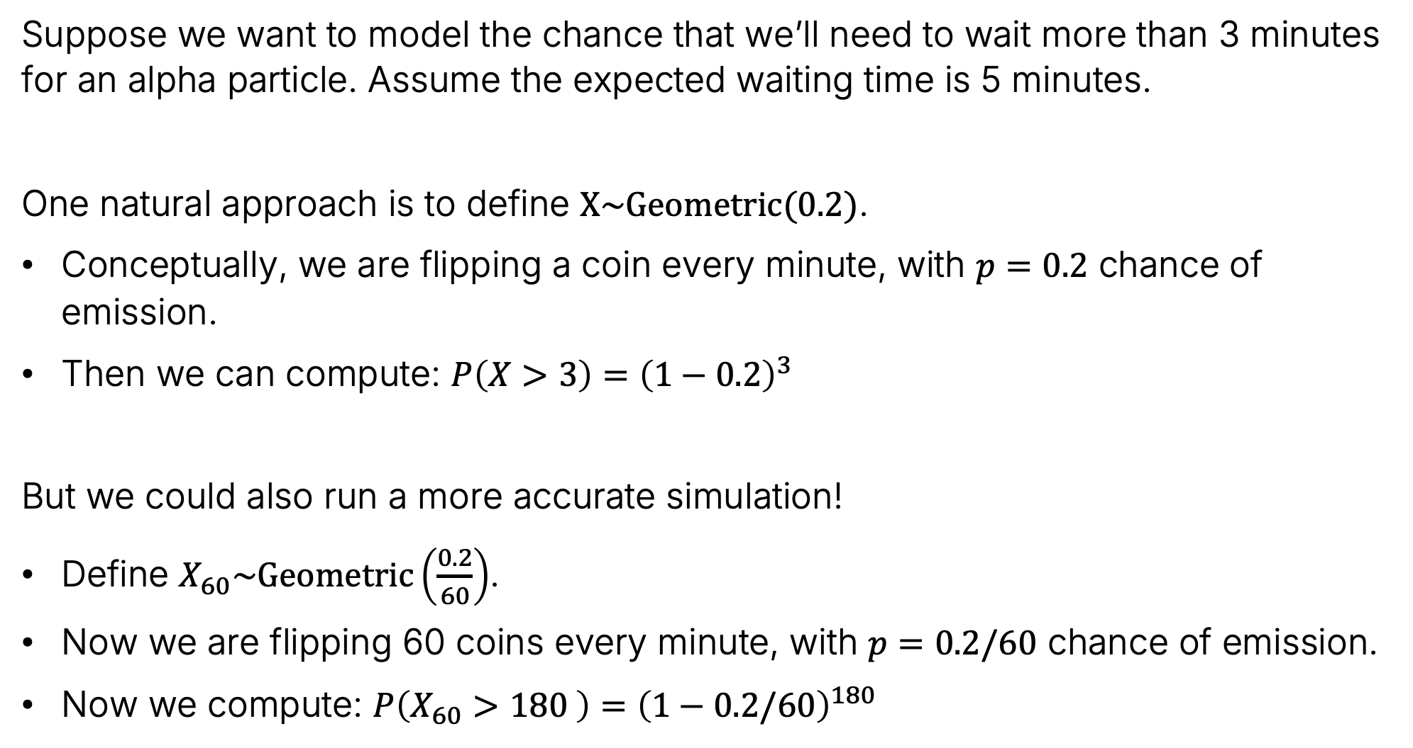
Modeling Problem: Waiting Time for an Emission
Suppose we want to model the chance that we’ll need to wait more than 3 minutes for an alpha particle. Assume the expected waiting time is 5 minutes.
One natural approach is to define $X\sim Geometric(0.2)$.
Conceptually, we are flipping a coin every minute, with $p=0.2$ chance of emission.
Then we can compute: $P\left(X>3\right)={\left(1−0.2\right)}^{3}$
But we could also run a more accurate simulation!
Define $X_{60}\sim Geometric\left(\frac{0.2}{60}\right)$.
Now we are flipping 60 coins every minute, with $p=0.2/60$ chance of emission.
Now we compute: $P\left(X_{60}>180 \right)={\left(1−0.2/60\right)}^{180}$

Slide 21
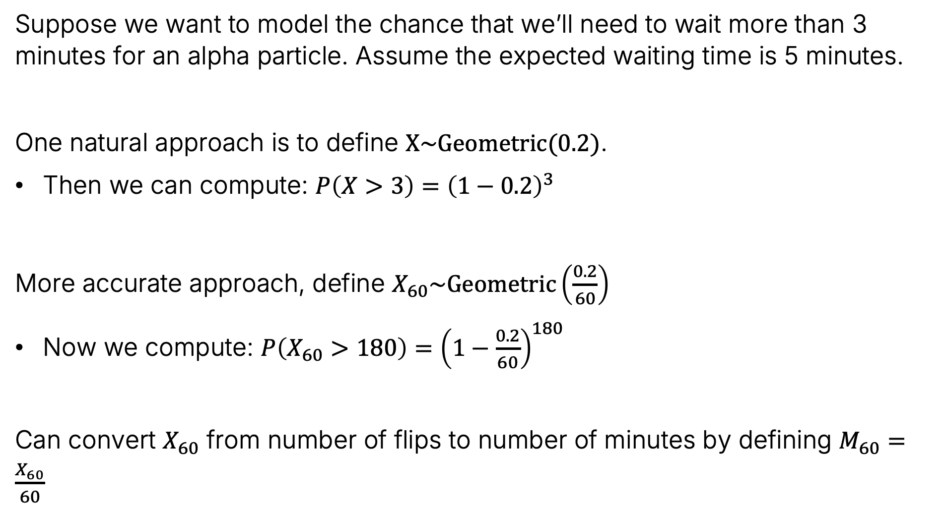
Modeling Problem: Waiting Time for an Emission
Suppose we want to model the chance that we’ll need to wait more than 3 minutes for an alpha particle. Assume the expected waiting time is 5 minutes.
One natural approach is to define $X\sim Geometric(0.2)$.
Then we can compute: $P\left(X>3\right)={\left(1−0.2\right)}^{3}$
More accurate approach, define $X_{60}\sim Geometric\left(\frac{0.2}{60}\right)$
Now we compute: $P\left(X_{60}>180\right)={\left(1−\frac{0.2}{60}\right)}^{180}$
Can convert $X_{60}$ from number of flips to number of minutes by defining $M_{60}=\frac{X_{60}}{60}$

Slide 22
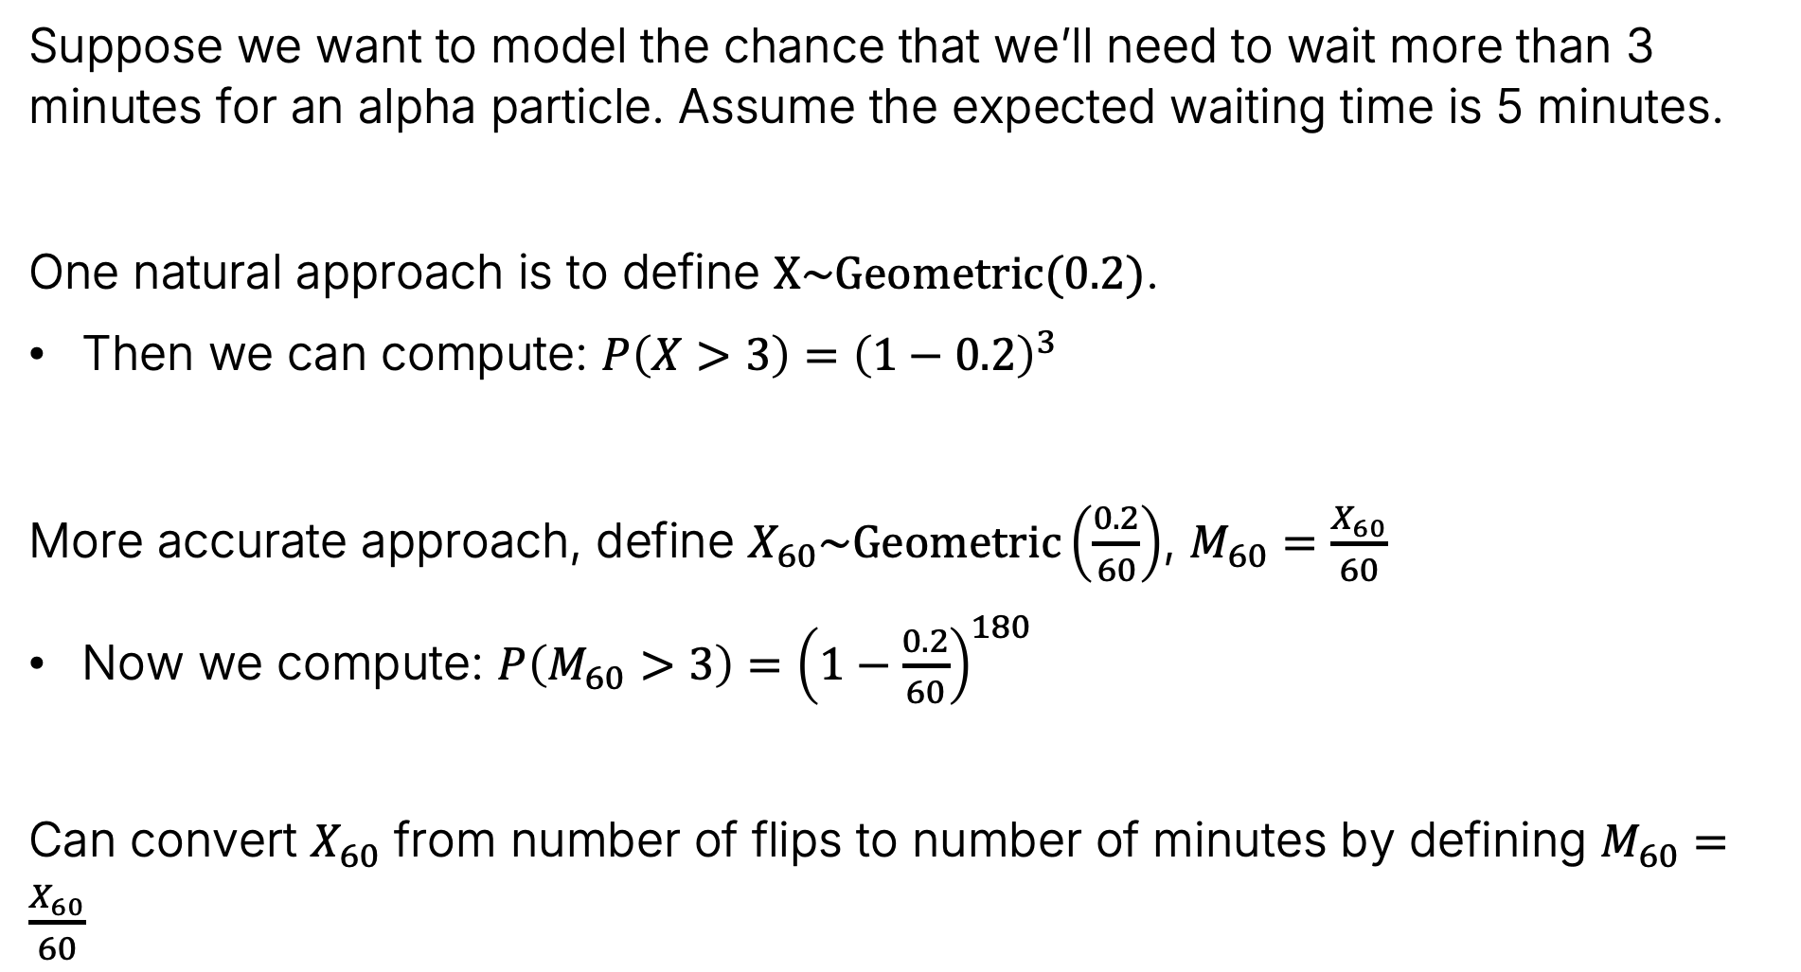
Modeling Problem: Waiting Time for an Emission
Suppose we want to model the chance that we’ll need to wait more than 3 minutes for an alpha particle. Assume the expected waiting time is 5 minutes.
One natural approach is to define $X\sim Geometric(0.2)$.
Then we can compute: $P\left(X>3\right)={\left(1−0.2\right)}^{3}$
More accurate approach, define $X_{60}\sim Geometric\left(\frac{0.2}{60}\right)$, $M_{60}=\frac{X_{60}}{60}$
Now we compute: $P\left(M_{60}>3\right)={\left(1−\frac{0.2}{60}\right)}^{180}$
Can convert $X_{60}$ from number of flips to number of minutes by defining $M_{60}=\frac{X_{60}}{60}$

Slide 23
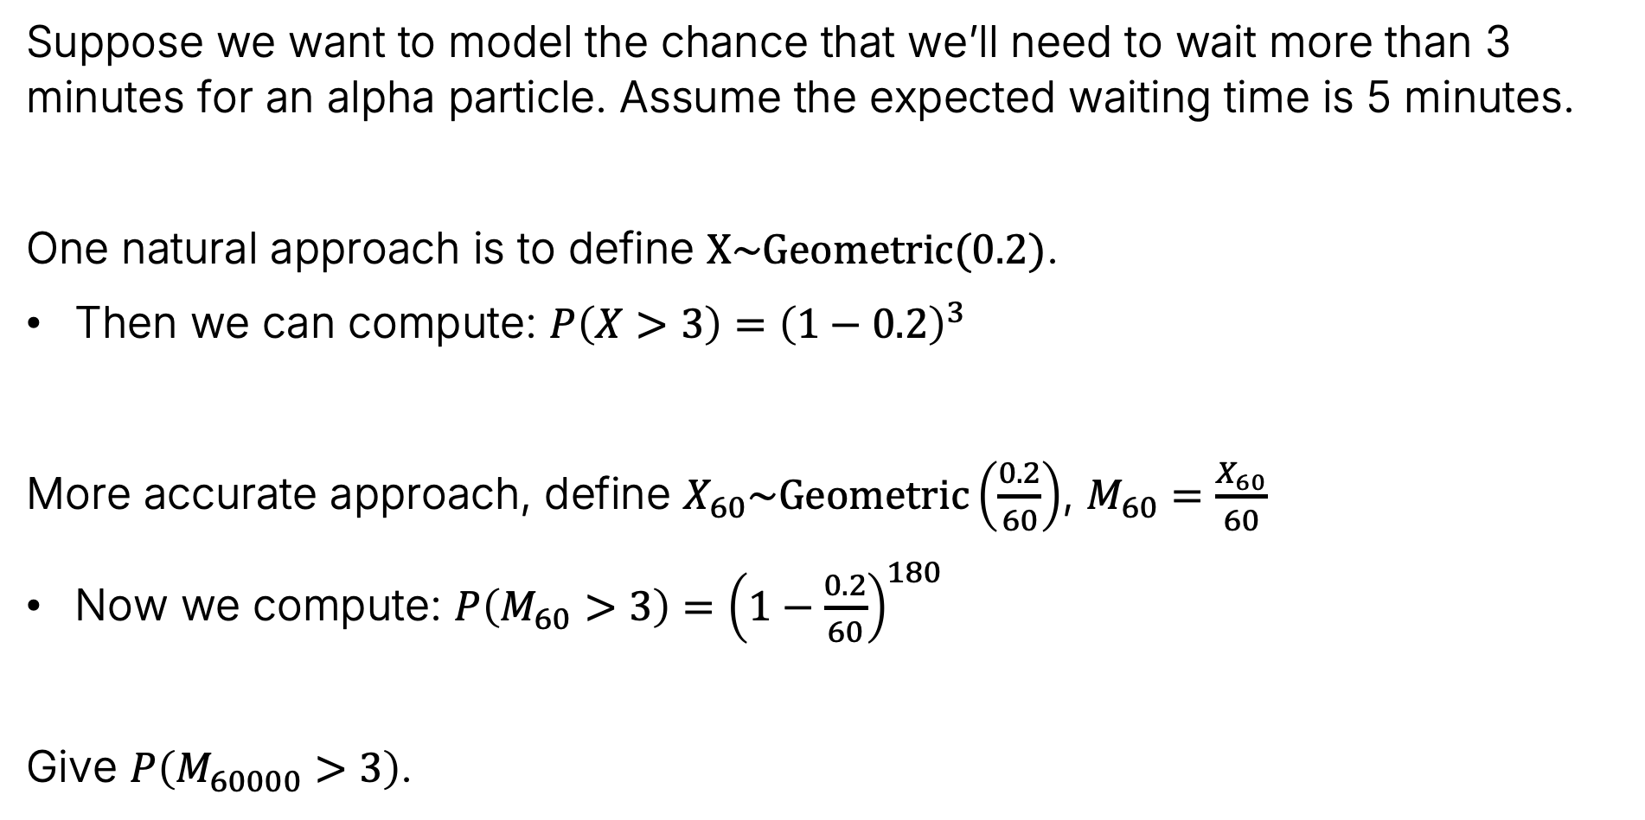
Modeling Problem: Waiting Time for an Emission
Suppose we want to model the chance that we’ll need to wait more than 3 minutes for an alpha particle. Assume the expected waiting time is 5 minutes.
One natural approach is to define $X\sim Geometric(0.2)$.
Then we can compute: $P\left(X>3\right)={\left(1−0.2\right)}^{3}$
More accurate approach, define $X_{60}\sim Geometric\left(\frac{0.2}{60}\right)$, $M_{60}=\frac{X_{60}}{60}$
Now we compute: $P\left(M_{60}>3\right)={\left(1−\frac{0.2}{60}\right)}^{180}$
Give $P\left(M_{60000}>3\right)$.

Slide 24
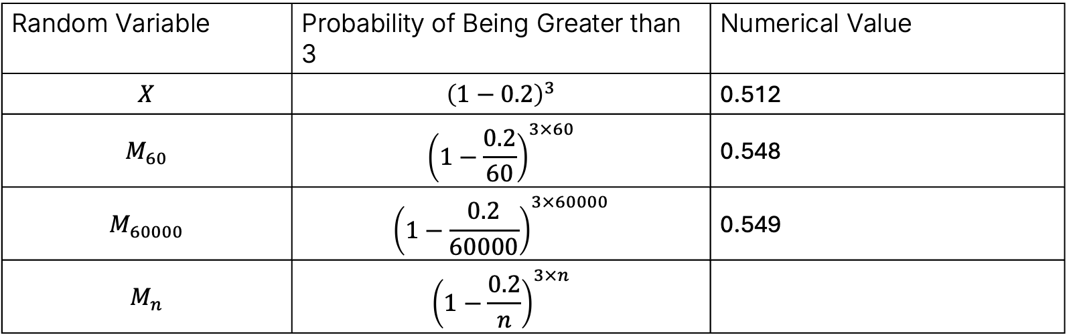
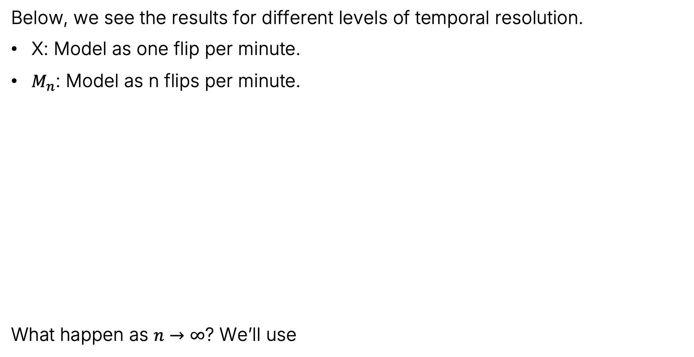
Result vs. Temporal Resolution
Below, we see the results for different levels of temporal resolution.
X: Model as one flip per minute.
$M_{n}$: Model as n flips per minute.
What happen as $n→∞$? We’ll use
Random Variable | Probability of Being Greater than 3 | Numerical Value
$$X$$ | $${\left(1−0.2\right)}^{3}$$ | 0.512
$$M_{60}$$ | $${\left(1−\frac{0.2}{60}\right)}^{3×60}$$ | 0.548
$$M_{60000}$$ | $${\left(1−\frac{0.2}{60000}\right)}^{3×60000}$$ | 0.549
$$M_{n}$$ | $${\left(1−\frac{0.2}{n}\right)}^{3×n}$$
$$\lim_{n→∞}{{\left(1−1/x\right)}^{x}=e^{−1}}$$

Slide 25

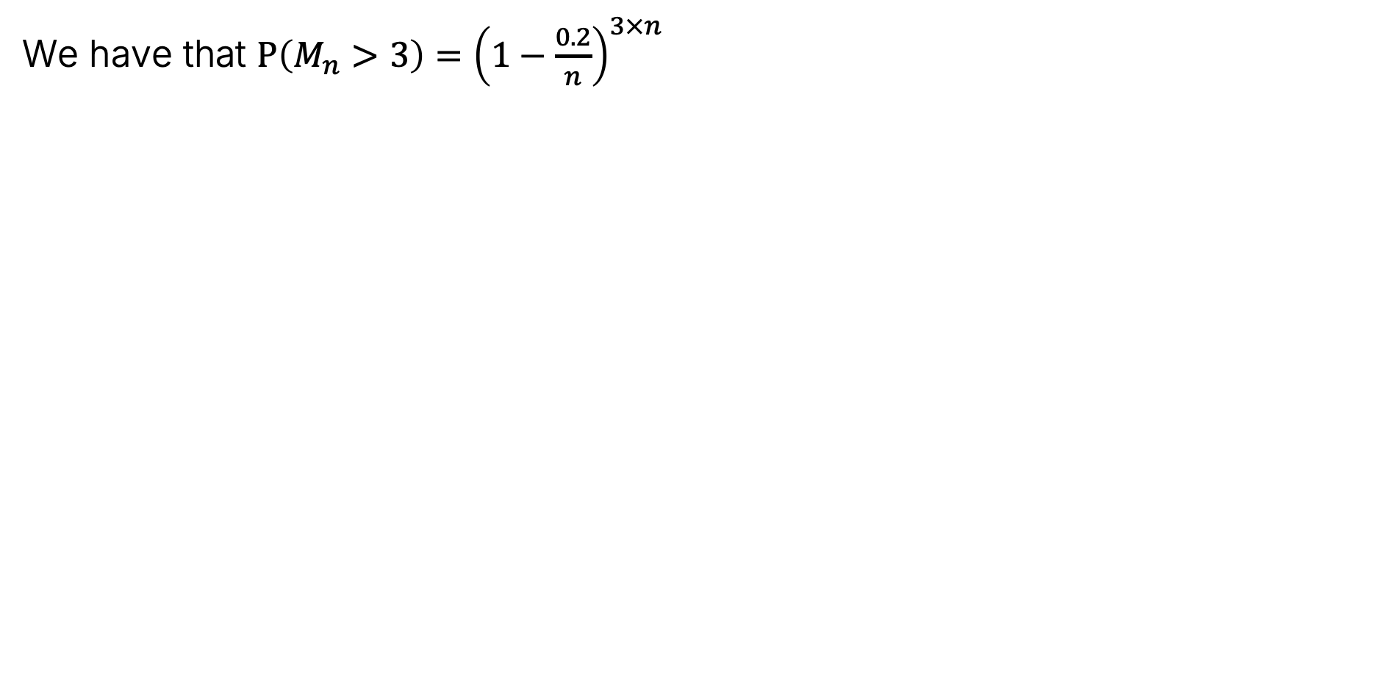


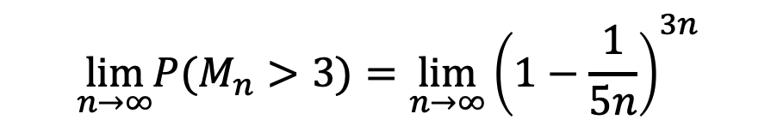
Closed Form for Infinite Temporal Resolution
We have that $P\left(M_{n}>3\right)={\left(1−\frac{0.2}{n}\right)}^{3×n}$
$$\lim_{n→∞}{{\left(1−1/x\right)}^{x}=e^{−1}}$$
$$\lim_{n→∞}{P(M}_{n}>3)=\lim_{n→∞}{{\left(1−\frac{1}{5n}\right)}^{3n}}$$
Let $q=5n$
$$=\lim_{q→∞}{{\left(1−\frac{1}{q}\right)}^{q⋅\frac{3}{5}}}$$
$$=\lim_{q→∞}{{\left({\left(1−\frac{1}{q}\right)}^{q}\right)}^{3/5}}$$
$${=\left(e^{−1}\right)}^{3/5}$$
$$=e^{−3/5}$$

Slide 26

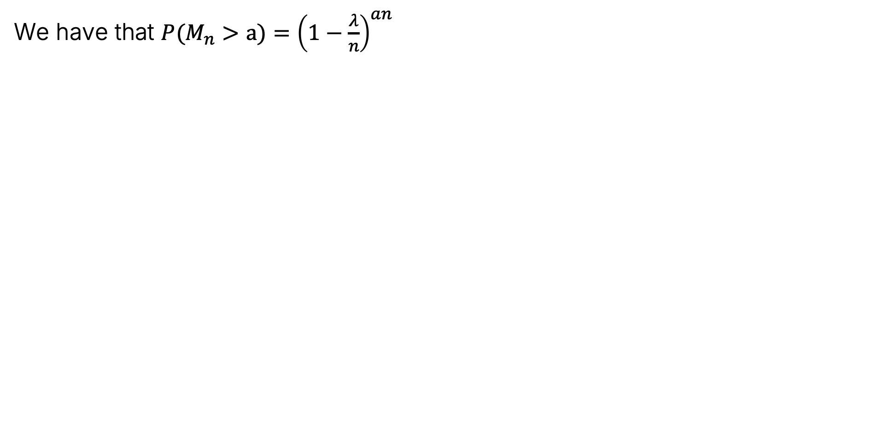


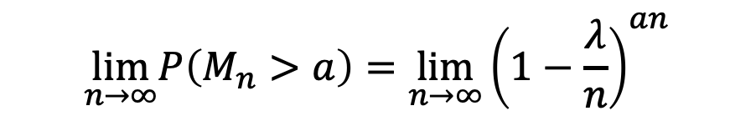
Closed Form for Infinite Temporal Resolution (More General)
We have that ${P(M}_{n}>a)={\left(1−\frac{λ}{n}\right)}^{an}$
$$\lim_{n→∞}{{\left(1−1/x\right)}^{x}=e^{−1}}$$
$$\lim_{n→∞}P\left(M_{n}>a\right)=\lim_{n→∞}{{\left(1−\frac{λ}{n}\right)}^{an}}$$
Let $q=n/λ$
$$=\lim_{q→∞}{{\left(1−\frac{1}{q}\right)}^{aλq}}$$
$$=\lim_{q→∞}{{\left({\left(1−\frac{1}{q}\right)}^{q}\right)}^{aλ}}$$
$${=\left(e^{−1}\right)}^{aλ}$$
$$=e^{−aλ}$$

Slide 27
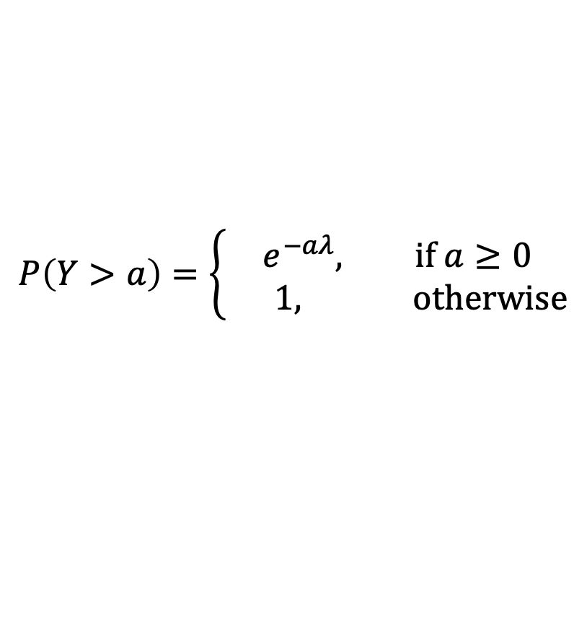
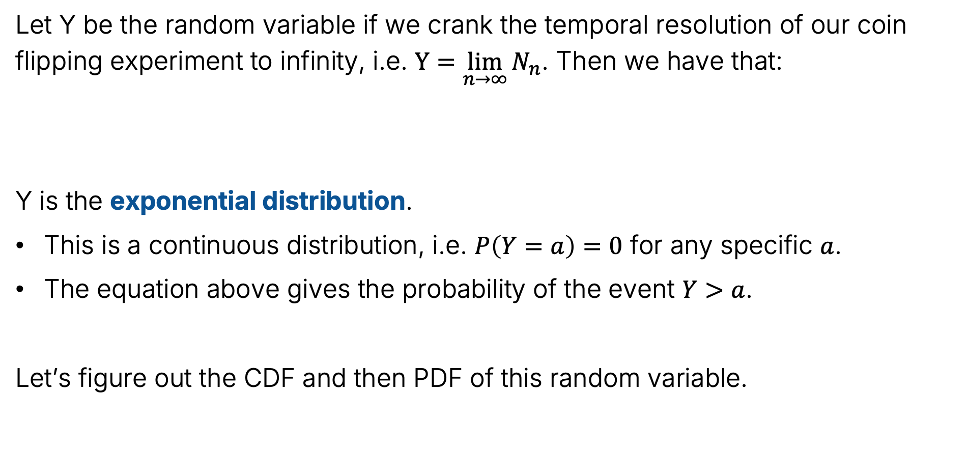
Exponential Distribution
Let Y be the random variable if we crank the temporal resolution of our coin flipping experiment to infinity, i.e. $Y=\lim_{n→∞}{N_{n}}$. Then we have that:
Y is the exponential distribution.
This is a continuous distribution, i.e. $P\left(Y=a\right)=0$ for any specific $a$.
The equation above gives the probability of the event $Y>a$.
Let’s figure out the CDF and then PDF of this random variable.
$$P\left(Y>a\right)=\left\{\begin{aligned}e^{−aλ}, if a≥0 \\ 1, otherwise\end{aligned}\right.$$

Slide 28

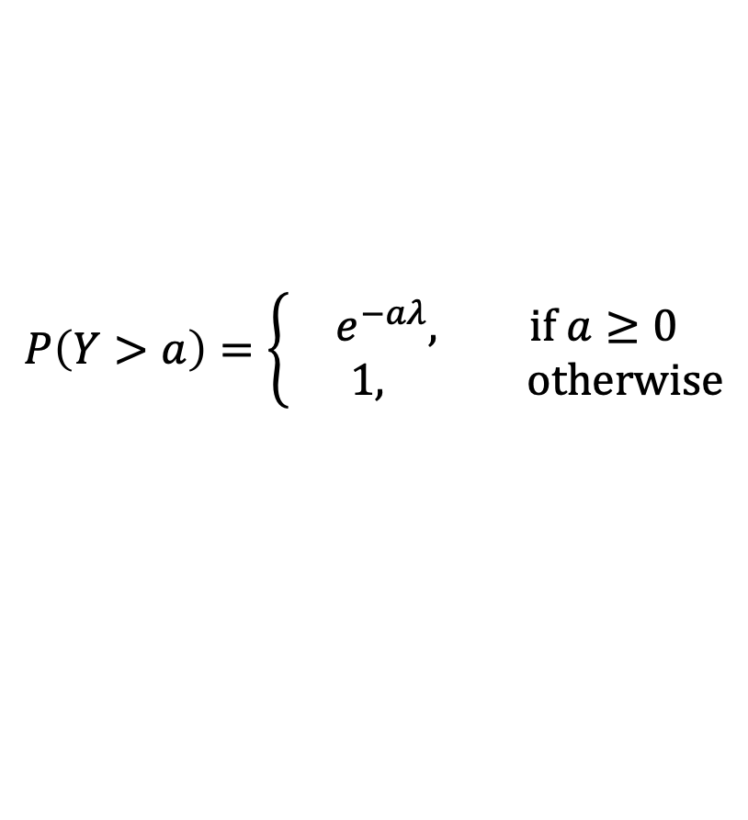
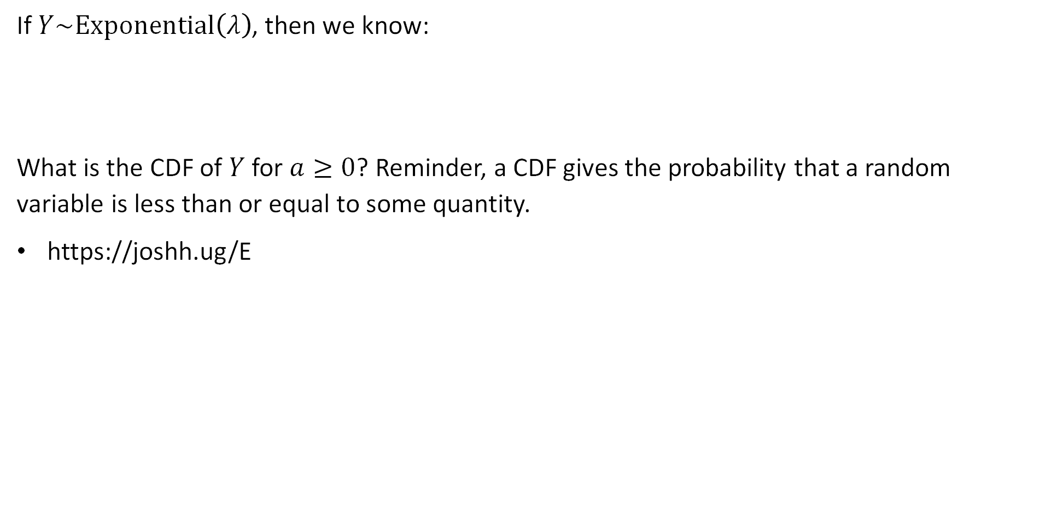
Exponential Distribution
If $Y\sim Exponential\left(λ\right)$, then we know:
What is the CDF of $Y$ for $a≥0$? Reminder, a CDF gives the probability that a random variable is less than or equal to some quantity.
https://joshh.ug/E
$$P\left(Y>a\right)=\left\{\begin{aligned}e^{−aλ}, if a≥0 \\ 1, otherwise\end{aligned}\right.$$

Slide 29

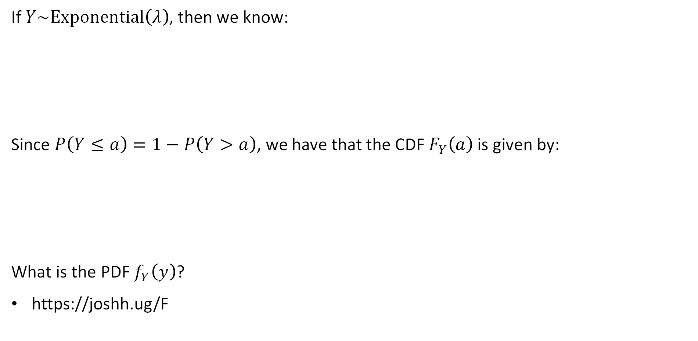
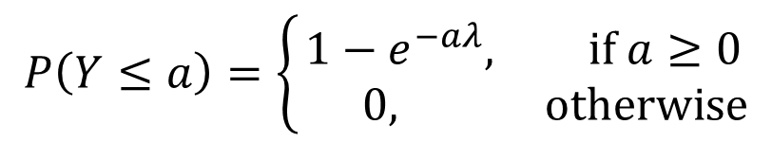
Exponential Distribution
If $Y\sim Exponential\left(λ\right)$, then we know:
Since $P\left(Y≤a\right)=1−P\left(Y>a\right)$, we have that the CDF $F_{Y}\left(a\right)$ is given by:
What is the PDF $f_{Y}\left(y\right)$?
https://joshh.ug/F
$$P\left(Y>a\right)=\left\{\begin{aligned}e^{−aλ}, if a≥0 \\ 1, otherwise\end{aligned}\right.$$
$$P\left(Y≤a\right)=\left\{\begin{aligned}{1−e}^{−aλ}, if a≥0 \\ 0, otherwise\end{aligned}\right.$$

Slide 30
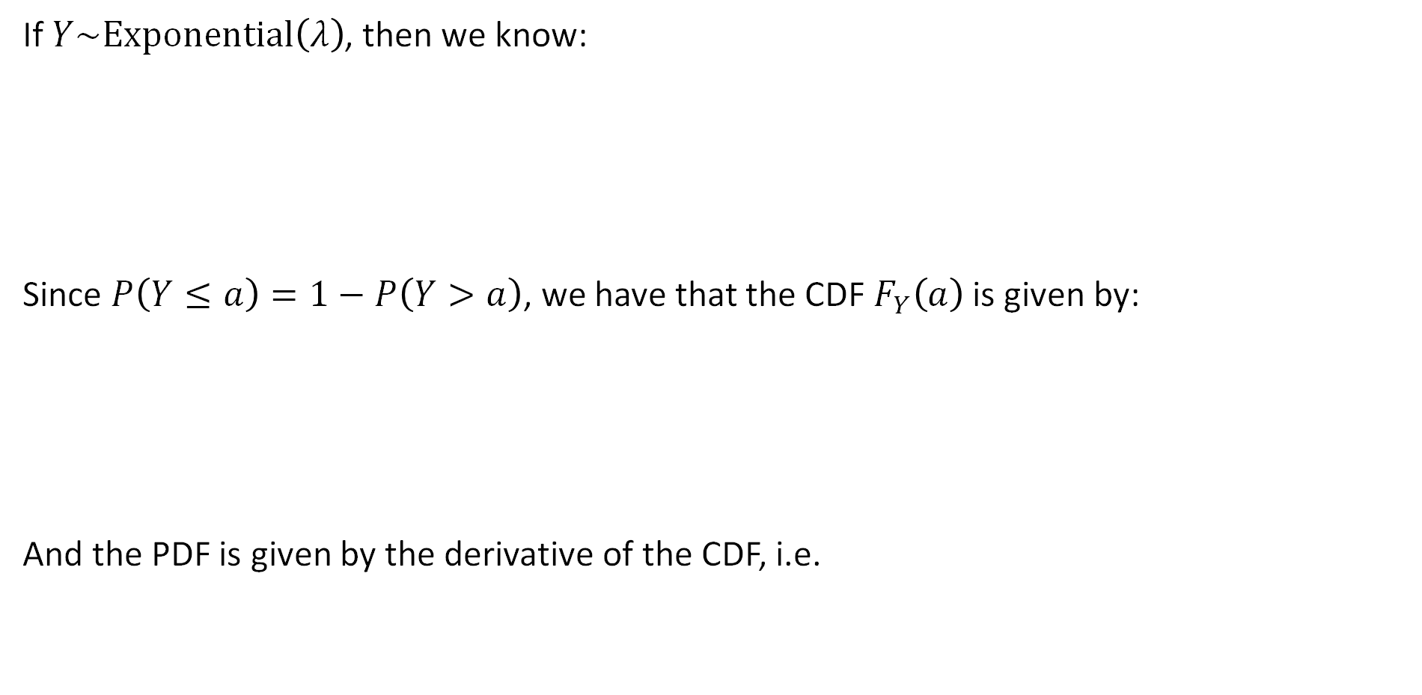
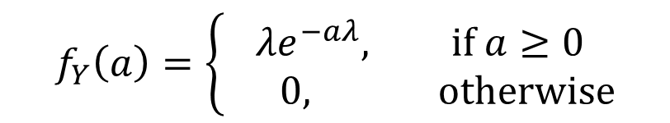

Exponential Distribution
If $Y\sim Exponential\left(λ\right)$, then we know:
Since $P\left(Y≤a\right)=1−P\left(Y>a\right)$, we have that the CDF $F_{Y}\left(a\right)$ is given by:
And the PDF is given by the derivative of the CDF, i.e.
$$P\left(Y>a\right)=\left\{\begin{aligned}e^{−aλ}, if a≥0 \\ 1, otherwise\end{aligned}\right.$$
$$F_{Y}\left(a\right)=\left\{\begin{aligned}{1−e}^{−aλ}, if a≥0 \\ 0, otherwise\end{aligned}\right.$$
$$f_{Y}\left(a\right)=\left\{\begin{aligned}{λe}^{−aλ}, if a≥0 \\ 0, otherwise\end{aligned}\right.$$

Slide 31




Application of an Exponential Random Variable
Suppose that the that the number of minutes until the next neutrino detection is given by $X\sim Exponential(0.02)$.
What is the chance that the next neutrino detection occurs in the next 100 minutes?
https://joshh.ug/G
$$F_{Y}\left(y\right)=\left\{\begin{aligned}{1−e}^{−λy}, if y≥0 \\ 0, otherwise\end{aligned}\right.$$
$$f_{Y}\left(y\right)=\left\{\begin{aligned}{λe}^{−λy}, if a≥0 \\ 0, otherwise\end{aligned}\right.$$

Slide 32

Application of an Exponential Random Variable
Suppose that the that the number of minutes until the next neutrino detection is given by $X\sim Exponential(0.02)$.
What is the chance that the next neutrino detection occurs in the next 100 minutes?
Easiest to use the CDF! We want $F_{Y}\left(100\right)=P\left(Y<100\right)$
$$F_{Y}\left(y\right)=\left\{\begin{aligned}{1−e}^{−λy}, if y≥0 \\ 0, otherwise\end{aligned}\right.$$
$$=1−e^{−100∗0.02}$$
$$=86.47\%$$

Slide 33


The PDF and CDF of an Exponential Random Variable (Visually)
Below are the PDF and CDF of $X\sim Exponential(2)$.
From the plot, how do we verify the area under the PDF is 1?

Slide 34
Expectation and Variance
Lecture 23, CS70 Fall 2025

Slide 35
Expectation of a Continuous Random Variable
What do you think are the expectations of the random variables below?

Slide 36
Expectation of a Continuous Random Variable
What do you think are the expectations of the random variables below?
x=1
x=0

Slide 37


Expectation of a Geometric Random Variable
What do you think is the expectation of $X\sim Geometric(2)$?
https://joshh.ug/H

Slide 38

Definition of Expectation for Continuous Random Variable
If $X$ is a random variable with PDF $f_{X}\left(x\right)$, then $𝔼\left[X\right]$ is:
$$𝔼\left[X\right]=\int_{−∞}^{∞}{x⋅f_{X}\left(x\right)dx}$$
Contrast with our discrete expectation formula:
$$𝔼\left[X\right]=\sum_{x∈range(X)}{x⋅P(X=x)}$$

Slide 39




Expectation for $X\sim Geometric\left(λ\right)$
To compute the $𝔼\left[X\right]$ where $X\sim Geometric\left(λ\right)$, we integrate over the PDF of our exponential random variable.
$$f_{X}\left(x\right)=\left\{\begin{aligned}{λe}^{−λx}, if x≥0 \\ 0, otherwise\end{aligned}\right.$$
$$𝔼\left[X\right]=\int_{0}^{∞}{x⋅λe^{−λx}dx}$$
Recall Integration by Parts from HW1:
$$\int_{a}^{b}{u\left(x\right)⋅v^{′}\left(x\right)dx={\left.u\left(x\right)⋅v\left(x\right)\right|}_{a}^{b}}−\int_{a}^{b}{u^{′}\left(x\right)⋅v\left(x\right)dx}$$

Slide 40










Expectation for $X\sim Geometric\left(λ\right)$
To compute the $𝔼\left[X\right]$ where $X\sim Geometric\left(λ\right)$, we integrate over the PDF of our exponential random variable.
$$f_{X}\left(x\right)=\left\{\begin{aligned}{λe}^{−λx}, if x≥0 \\ 0, otherwise\end{aligned}\right.$$
$$𝔼\left[X\right]=\int_{0}^{∞}{x⋅λe^{−λx}dx}$$
$$−\int_{0}^{∞}{1⋅\left(−e^{−λx}\right)}dx$$
$${\left.x⋅\left(−e^{−λx}\right)\right|}_{0}^{∞}$$
$$=$$
$$−{\left.\frac{e^{−λx}}{λ}\right|}_{0}^{∞}$$
$$=\frac{1}{λ}$$
$$u(x)$$
$$=0$$
$$v′(x)$$
Recall Integration by Parts from HW1:
$$\int_{a}^{b}{u\left(x\right)⋅v^{′}\left(x\right)dx={\left.u\left(x\right)⋅v\left(x\right)\right|}_{a}^{b}}−\int_{a}^{b}{u^{′}\left(x\right)⋅v\left(x\right)dx}$$

Slide 41

Expectation of a Geometric Random Variable
What do you think is the expectation of $X\sim Geometric(2)$?
Answer:$1/λ=1/2$

Slide 42


Definition of Variance for Continuous Random Variable
If $X$ is a random variable with PDF $f_{X}\left(x\right)$, then $var\left(X\right)$ is:
$$var\left(X\right)=𝔼\left[X^{2}\right]−𝔼{\left[X\right]}^{2}$$
$$=\int_{−∞}^{∞}{x^{2}⋅f_{X}\left(x\right)dx}−{\left(\int_{−∞}^{∞}{x⋅f_{X}\left(x\right)dx}\right)}^{2}$$

Slide 43








Expectation for $X\sim Geometric\left(λ\right)$
To compute the variance, we’ll need $𝔼\left[X^{2}\right]$. Luckily this isn’t so bad.
$$f_{X}\left(x\right)=\left\{\begin{aligned}{λe}^{−λx}, if x≥0 \\ 0, otherwise\end{aligned}\right.$$
$$𝔼\left[X\right]=\int_{0}^{∞}{λxe^{−λx}dx=\frac{1}{λ}}$$
$$𝔼\left[X^{2}\right]=\int_{0}^{∞}{x^{2}⋅λe^{−λx}dx}$$
$$−\int_{0}^{∞}{2x⋅\left(−e^{λx}\right)}dx$$
$${\left.x^{2}⋅\left(−e^{−λx}\right)\right|}_{0}^{∞}$$
$$=$$
$$+\frac{2}{λ}\int_{0}^{∞}{λxe^{−λx}}dx$$
$$=\frac{2}{λ}⋅\frac{1}{λ}=\frac{2}{λ^{2}}$$
$$u(x)$$
$$=0$$
$$v′(x)$$
Recall Integration by Parts from HW1:
$$\int_{a}^{b}{u\left(x\right)⋅v^{′}\left(x\right)dx={\left.u\left(x\right)⋅v\left(x\right)\right|}_{a}^{b}}−\int_{a}^{b}{u^{′}\left(x\right)⋅v\left(x\right)dx}$$

Slide 44


Expectation for $X\sim Geometric\left(λ\right)$
To compute the variance, we’ll need $𝔼\left[X^{2}\right]$. Luckily this isn’t so bad.
$$f_{X}\left(x\right)=\left\{\begin{aligned}{λe}^{−λx}, if x≥0 \\ 0, otherwise\end{aligned}\right.$$
$$𝔼\left[X\right]=\int_{0}^{∞}{λxe^{−λx}dx=\frac{1}{λ}}$$
$$𝔼\left[X^{2}\right]=\frac{2}{λ^{2}}$$
$$var\left(X\right)=\frac{2}{λ^{2}}−\frac{1}{λ^{2}}=\frac{1}{λ^{2}}$$

Slide 45





Geometric vs. Exponential
Compare $C\sim Exponential\left(λ\right)$ and $D\sim Geometric\left(λ\right)$
$$𝔼\left[C\right]=\frac{1}{λ}$$
$$𝔼\left[D\right]=\frac{1}{λ}$$
$$var(C)=\frac{1}{λ^{2}}$$
$$var(D)=\frac{1−λ}{λ^{2}}$$

Slide 46







Geometric vs. Exponential
Compare $C\sim Exponential\left(λ\right)$ and $D\sim Geometric\left(λ\right)$
$$PDF: f\left(d\right)=λe^{−λd}$$
$$PMF: {\left(1−λ\right)}^{d−1}λ$$
$$𝔼\left[C\right]=\frac{1}{λ}$$
$$𝔼\left[D\right]=\frac{1}{λ}$$
$$var(C)=\frac{1}{λ^{2}}$$
$$var(D)=\frac{1−λ}{λ^{2}}$$

Slide 47





Expectation and Variance of a Uniform Random Variable
In the notes, they show that if $X$ is a uniform random variable over $\left[0, ℓ\right]$:
See notes (or just show yourself) for a proof. Contrast with $D$ uniform over $\left\{1, 2, …, n\right)$, which was:
$$𝔼\left[X\right]=\frac{ℓ}{2}$$
$$var\left(X\right)=\frac{ℓ^{2}}{12}$$
$$𝔼\left[D\right]=\frac{n+1}{2}$$
$$var\left(X\right)=\frac{n^{2}−1}{12}$$

Slide 48
Joint Distributions and Independence
Lecture 23, CS70 Fall 2025

Slide 49
Joint Distributions and Independence
Our usual ideas from discrete probability around joint distributions, marginal distributions, and independence carry over very closely.

Slide 50


Review: Joint Distributions (Discrete)
To refresh our memory on joint distributions, let’s first consider the joint PMF of two discrete uniform random variables $X$ and$Y$ representing the roll of two independent four sided dice.
What is the joint PMF of $X$ and $Y$?
$$x$$ | $$y$$ | $$P\left(X=x,Y=y\right)$$
1 | 1 | 1/16
1 | 2 | 1/16
1 | 3 | 1/16
1 | 4 | 1/16
2 | 1 | 1/16
2 | 2 | 1/16
2 | 3 | 1/16
2 | 4 | 1/16
3 | 1 | 1/16
3 | 2 | 1/16
3 | 3 | 1/16
3 | 4 | 1/16
4 | 1 | 1/16
4 | 2 | 1/16
4 | 3 | 1/16
4 | 4 | 1/16

Slide 51



Joint Density
Suppose we have random variables $X$ and $Y$ which are continuous. Then their joint PDF is a non-negative function $f_{X,Y}\left(x,y\right)$ such that:
And for all $a<b$ and $c<d$, we have:
Can interpret PDF as probability that we are in a small rectangle around $x, y$.
Actual probability is zero since the rectangle infinitesimal.
$$\int_{−∞}^{∞}{\int_{−∞}^{∞}{f_{X,Y}\left(x,y\right) dx dy }=1}$$
$$P\left(a≤X≤b, c≤Y≤d\right)=\int_{c}^{d}{\int_{a}^{b}{f_{X,Y}\left(x,y\right) dx dy }}$$

Slide 52


Joint Density Example
Suppose we have random variables $X$ and $Y$ which are continuous. Then their joint PDF is a non-negative function $f_{X,Y}\left(x,y\right)$ such that:
Suppose we throw a dart at the origin. Suppose we land uniformly within 2 feet of the origin.
$$\int_{−∞}^{∞}{\int_{−∞}^{∞}{f_{X,Y}\left(x,y\right) dx dy }=1}$$
$$f_{X,Y}\left(x,y\right)=\left\{\begin{aligned}\frac{1}{4π}, if x^{2}+y^{2} ≤4 \\ 0, otherwise\end{aligned}\right.$$
2 foot radius

Slide 53

Marginal Probabilities
Suppose we have random variables $X$ and $Y$ which are continuous. Then their joint PDF is a non-negative function $f_{X,Y}\left(x,y\right)$ such that:
Similar to marginal probabilities for discrete random variables, we can compute $f_{X}\left(x\right)$ and $f_{Y}\left(y\right)$. How?
$$\int_{−∞}^{∞}{\int_{−∞}^{∞}{f_{X,Y}\left(x,y\right) dx dy }=1}$$

Slide 54


Marginal Probabilities
Suppose we have random variables $X$ and $Y$ which are continuous. Then their joint PDF is a non-negative function $f_{X,Y}\left(x,y\right)$ such that:
Similar to marginal probabilities for discrete random variables, we can compute $f_{X}\left(x\right)$ and $f_{Y}\left(y\right)$. How?
$$\int_{−∞}^{∞}{\int_{−∞}^{∞}{f_{X,Y}\left(x,y\right) dx dy }=1}$$
$$f_{X}\left(x\right)=\int_{−∞}^{∞}{f_{X,Y}\left(x,y\right) dy }$$
$$f_{Y}\left(y\right)=\int_{−∞}^{∞}{f_{X,Y}\left(x,y\right) dx }$$

Slide 55




Marginal Density Example
Suppose we throw a dart at the origin. Suppose we land uniformly within 2 feet of the origin. Then $X$ and $Y$ are jointly distributed as:
What is the distribution of $X$, e.g. what is the p.d.f. $f_{X}\left(x\right)$?
$$f_{X,Y}\left(x,y\right)=\left\{\begin{aligned}\frac{1}{4π}, if x^{2}+y^{2} ≤4 \\ 0, otherwise\end{aligned}\right.$$
2 foot radius
$$f_{X}\left(x\right)=\int_{−∞}^{∞}{f_{X,Y}\left(x,y\right) dy }$$
Not typeset yet

Slide 56



Marginal Density Example
Suppose we throw a dart at the origin. Suppose we land uniformly within 2 feet of the origin. Then $X$ and $Y$ are jointly distributed as:
What is the distribution of $X$, e.g. what is the p.d.f. $f_{X}\left(x\right)$?
$$f_{X,Y}\left(x,y\right)=\left\{\begin{aligned}\frac{1}{4π}, if x^{2}+y^{2} ≤4 \\ 0, otherwise\end{aligned}\right.$$
2 foot radius
$$f_{X}\left(x\right)=\int_{minimum y}^{maximum y}{\frac{1}{4π}dy}$$
To find the min/max y, we have that
$$x^{2}+y^{2}≤4⇒y∈\left[−\sqrt{4−x^{2}},\sqrt{4−x^{2}}\right]$$
$$=\int_{−\sqrt{4−x^{2}}}^{\sqrt{4−x^{2}}}{\frac{1}{4π}dy}=\frac{2\sqrt{4−x^{2}}}{4π}=\frac{\sqrt{4−x^{2}}}{2π}$$
$$f_{X}\left(x\right)=\int_{−∞}^{∞}{f_{X,Y}\left(x,y\right) dy }$$

Slide 57

Marginal Density Example
Suppose we throw a dart at the origin. Suppose we land uniformly within 2 feet of the origin. Then $X$ and $Y$ are jointly distributed as:
What is the distribution of $X$, e.g. what is the p.d.f. $f_{X}\left(x\right)$?
$$f_{X}\left(x\right)=\left\{\begin{aligned}\frac{\sqrt{4−x^{2}}}{2π}, if x∈[−2, 2] \\ 0, otherwise\end{aligned}\right.$$
$$f_{X,Y}\left(x,y\right)=\left\{\begin{aligned}\frac{1}{4π}, if x^{2}+y^{2} ≤4 \\ 0, otherwise\end{aligned}\right.$$
2 foot radius

Slide 58

Independent Random Variables
We saw $X$ and $Y$ are independent continuous random variables if for all $a<b$ and $c<d$.
$$P\left(a≤X≤b, c≤Y≤d\right)=P\left(a≤X≤b\right)⋅P\left(c≤Y≤d\right)$$
Or equivalently: If $f_{X, Y}\left(x,y\right)=f_{X}\left(x\right)⋅f_{Y}\left(y\right)$ for all $x, y$
For the dart example earlier, where X and Y independent?
Why or why not?
2 foot radius

Slide 59

Independent Random Variables
We saw $X$ and $Y$ are independent continuous random variables if for all $a<b$ and $c<d$.
$$P\left(a≤X≤b, c≤Y≤d\right)=P\left(a≤X≤b\right)⋅P\left(c≤Y≤d\right)$$
Or equivalently: If $f_{X, Y}\left(x,y\right)=f_{X}\left(x\right)⋅f_{Y}\left(y\right)$ for all $x, y$
For the dart example earlier, where X and Y independent?
Not independent! Example If x = 2, y must be zero.
2 foot radius

Slide 60
Summary and Reflections
Continuous Probability Distributions
The Exponential Distribution
Expectation and Variance
Joint Distributions and Independence
Summary and Reflections
Lecture 23, CS70 Fall 2025

Slide 61

Discrete vs. Continuous Probability Distributions
Before today, our random variables variables had a discrete range, i.e. either finite or countably infinite. Example: $range\left(Geometric\right)=\left\{1, 2, …\right\}$
We considered the space of sample points first, e.g. $TTTTTH$, and later defined events in terms of sums of probabilities of sample points.
Example, if $X\sim Binomial(3, 0.5)$, then:
$P\left(X=1\right)=P\left(ω=HTT\right)+P\left(ω=THT\right)+P(ω=TTH)$
The probability of an event defined by random variable equality was given by the “probability mass function”. We did not use this term before today.
Example: pmf of $X$ above is $P\left(X=k\right)=\left({3 \atop k}\right){0.5}^{k}{0.5}^{k−3}$ for $k∈[0, 1, 2, 3]$

Slide 62

Discrete vs. Continuous Probability Distributions
Before today, our random variables variables had a discrete range, i.e. either finite or countably infinite. Example: $range\left(Geometric\right)=\left\{1, 2, …\right\}$
We considered the space of sample points first, e.g. $TTTTTH$, and later defined events in terms of sums of probabilities of sample points.
By contrast, for continuous probability distributions, we think about events first.
CDF gives $P\left(X≤a\right)$, which is the probability of the event that $X$ is less than or equal to a.
Probability of any specific outcome is zero!
More generally, we only ever care about the probability of intervals (or unions of intervals).
PDF is the continuous analog of the PMF, but PDF outputs are not probabilities.

